Slide 1
Recent Plasma Startup Experiments
in TJ-II and Heliotron J
IOS-2.3
K. Nagasaki
Institute of Advanced Energy, Kyoto University, Japan
E. Ascasibar
CIEMAT, Spain

Slide 2
Outline
N|| dependence of EC breakdown (TJ-II and Heliotron J)
X2 breakdown after application of Uloop (TJ-II)
NBI plasma startup assisted by 2.45GHz 5kW microwaves (Heliotron J)

Slide 3
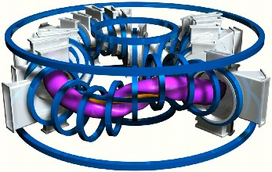
Experimental Conditions in TJ-II
magnetic field: B ₀ = 0.95 T
one gyrotron, 53.2 GHz, fixed power = 270 kW
fixed neutral hydrogen pressure = 2.7 x 10⁻⁵ mbar
two values of Npar: 0, 0.3
scan in toroidal electric field: 0 - 0.06 V/m

Slide 4
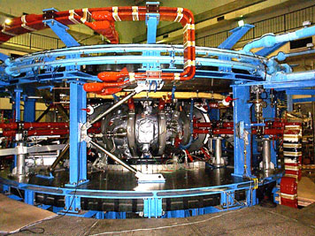
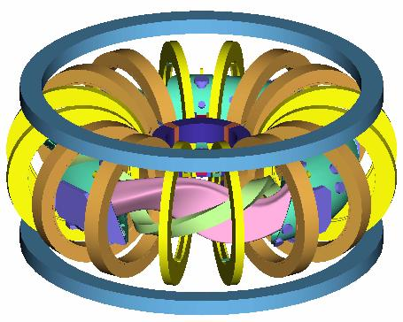
Experimental Conditions in Heliotron J
Major Radius: R=1.2 m
Plasma Minor Radius : a=0.1-0.2 m
Magnetic Field: B≦1.5 T
Vacuum iota: 0.3-0.8 with low magnetic shear
70GHz ECH system
Max. injection power : P_{EC}=0.4 MW
Focused Gaussian beam, w=30 mm
-0.05 < N|| < +0.6
Magnetic coil system :
one l/m=1/4 continuous helical coil
two sets of toroidal coils
three pairs of vertical field coils
Inner Vertical Coil
Outer Vertical Coil
Typical plasma parameters;
n_{e}=0.2-4 x 10¹⁹ m⁻³
T_{e}=0.3-1 keV
T_{i}=150-200 eV
Toroidal Coil A
Vacuum Chamber
Plasma
Toroidal Coil B
Helical Coil

Slide 5
N|| Dependence of X2 EC Breakdown in TJ-II and Heliotron J
The 2nd harmonic ECH breakdown is weakly dependent on N|| at N || <0.4 for high EC power (>190kW)
Longer delay time at N || >0.4 in Heliotron J may be related to shift of the resonance layer from magnetic axis
TJ-II
Heliotron J
20deg launch
20deg launch

Slide 6
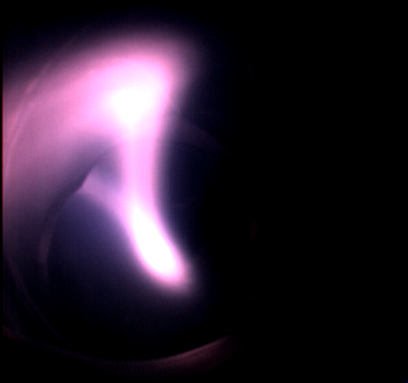
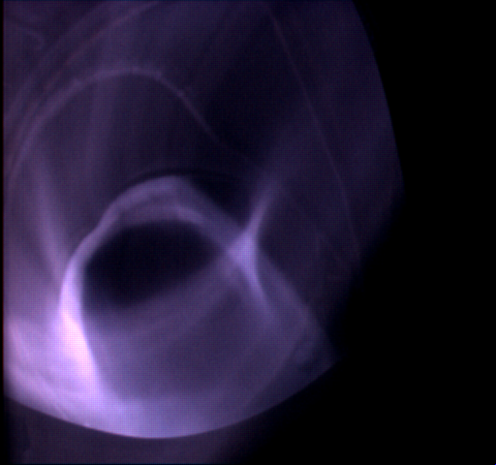
EC Breakdown with Fundamental Resonance in Heliotron J
The breakdown occurs quickly t_{d}~1msec when the fundamental resonance is located even outside the last closed flux surface
X2
O1

Slide 7
TJ-II Coil Currents

Slide 8
Confining Magnetic Surfaces during The Ramp-up of The currents
TJ-II
800 ms
850 ms
920 ms
1000 ms

Slide 9
Breakdown Time, τ_{bd}: Delay Between ECRH and H_{α} signal
TJ-II
τ_{bd}

Slide 10
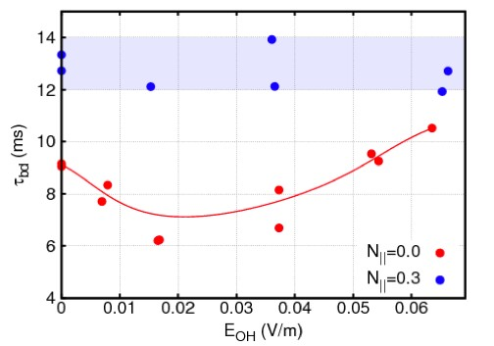
Breakdown Time Depends on Electric Field for Perp. Injection
TJ-II

Slide 11
NBI Plasmas Have Been Successfully Started Up By Assist of 2.45GHz 5kW Microwaves
Heliotron J
2.45 magnetron power P_{mag}=5kW
No ECH is applied
Kobayashi, Nucl. Fusion 51 (2011) 062002

Slide 12
Production of Low-Density Plasma and High-Energy Electrons by 2.45GHz Microwaves Is Important
Plasma is successfully started up when finite density (~10¹⁷ m⁻³) plasma is produced before NB injection and ECE intensity exceeds a critical value
2.45GHz Microwaves also hasten X2 ECH breakdown
No density build-up
Heliotron J

Slide 13
Conclusion (Preliminary)
The X2 breakdown is weakly dependent on N|| at N||<0.4 for high EC power in TJ-II and Heliotron J
The EC breakdown occurs quickly when the fundamental resonance is located inside the vacuum chamber even outside last closed flux surface
X2 breakdown with perpendicular injection shows a dependence on the loop voltage in TJ-II
2.45GHz 5kW microwaves are very efficient to assist NBI startup in Heliotron J
Production of low-density plasma (~10¹⁷m⁻³)
Role of high-energy electrons for X2 breakdown and assist of NB ionization

