Slide 1
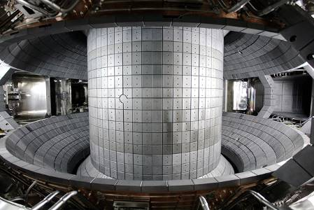
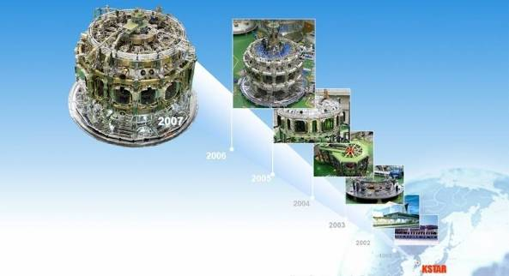








Recent Results of KSTAR
H-modes, ELM Mitigations
And TM stabilisation
Yong-Su Na on behalf of the KSTAR Team

Slide 2
Contents
    Short introduction to KSTAR
    H-modes
      L-H transition power threshold
      Characteristics of H-mode discharges
      Effect of ECRH on rotation
    Control of Edge Localized Modes
      Effect of resonant magnetic perturbation
      Direct pedestal heating by ECRH
      ELM mitigation by SMBI
      ELM pacemaking by Vertical jog
    Control of Tearing Modes
2

Slide 3
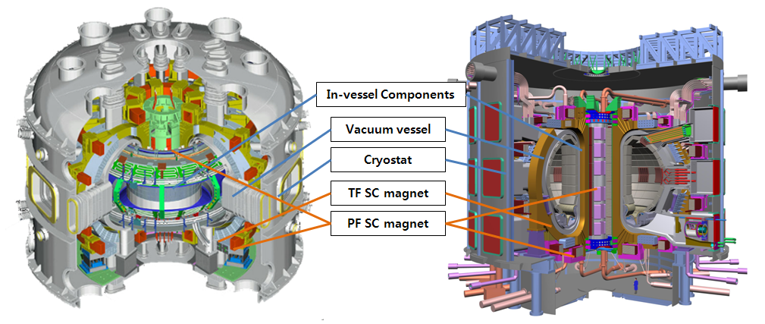
KSTAR Mission and Achievements
KSTAR Mission
KSTAR Parameters
PARAMETERS
Designed
Achieved
To achieve the superconducting tokamak construction and operation experiences, and
To develop high performance steady-state operation physics and technologies that are essential for ITER and fusion reactor development
Major radius, R₀
Minor radius, a
Elongation, κ
Triangularity, δ
Plasma volume
Bootstrap Current, f_{bs}
PFC Materials
Plasma shape
Plasma current, I_{P}
Toroidal field, B₀
Pulse length
β_{N}
Plasma fuel
Superconductor
Auxiliary heating /CD
Cryogenic
1.8 m
0.5 m
2.0
0.8
17.8 m³
> 0.7
C, CFC (W)
DN, SN
2.0 MA
3.5 T
300 s
5.0
H, D
Nb₃Sn, NbTi
~ 28 MW
9 kW @4.5K
1.8 m
0.5 m
2.0
0.8
17.8 m³
-
C
DN
1.0 MA
3.6 T
10 s
> 1.5
H, D, He
Nb₃Sn, NbTi
2.0 MW
5 kW @4.5 K
Black : achieved
Red : by 2011
3

Slide 4
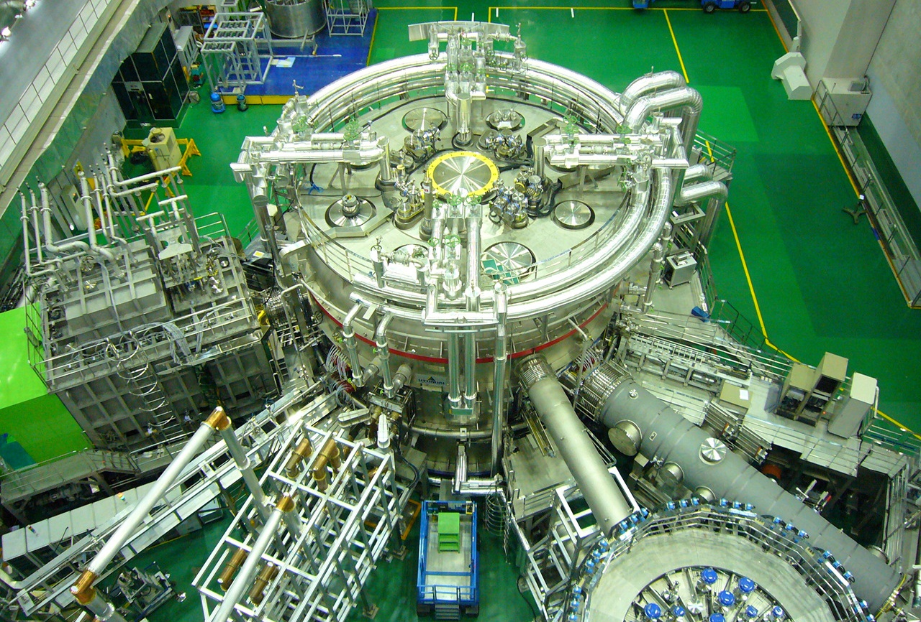
KSTAR Device for 2011 Campaign
PFC Baking & Cooling
200 C
NBI-1
100 keV
1.5 MW, 10 s
ECH
170 GHz
0.7 MW, cw
ECH
84 GHz / 110 GHz
0.3 MW, 2 s
vacuum pumping
ICRF
0.5MW, 1s
Cryogenic helium supply
4.5 K, 600 g/s

Slide 5
Contents
    Short introduction to KSTAR
    H-modes
      L-H transition power threshold
      Characteristics of H-mode discharges
      Effect of ECRH on rotation
    Control of Edge Localized Modes
      Effect of resonant magnetic perturbation
      Direct pedestal heating by ECRH
      ELM mitigation by SMBI
      ELM pacemaking by Vertical jog
    Control of Tearing Modes
5

Slide 6
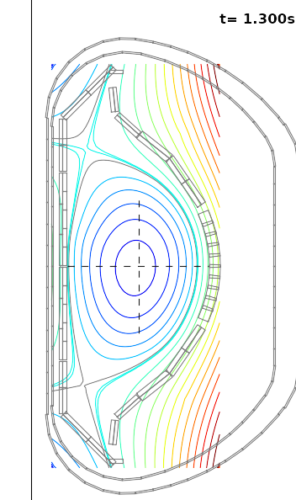
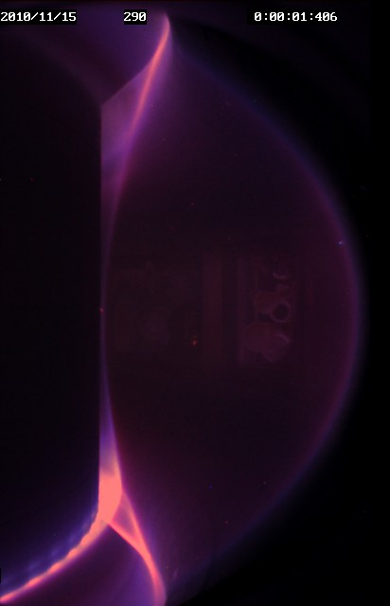
Typical H-mode in KSTAR (2010)
#4333
H-mode
ELMs
D_{a}
sharp increase of edge ECE
~30 shots achieved in 5 days
B_{T} = 2 T, I_{p} ~ 0.6 MA, n_{e} ~ 2e19 m⁻³
P_{NBI} ~ 1.3 MW (80 keV, co-NBI)
P_{ECH} ~ 0.25 MW (cntr-injection to Ip)
P_{OH} ~ 0.2 MW
Double null, κ ~ 1.8, R ~ 1.8 m, a ~ 0.5 m
Boronization with carborane
P_{thres} ~1.1 MW (ITER physics basis, 1999)
~80% increase of βp

Slide 7
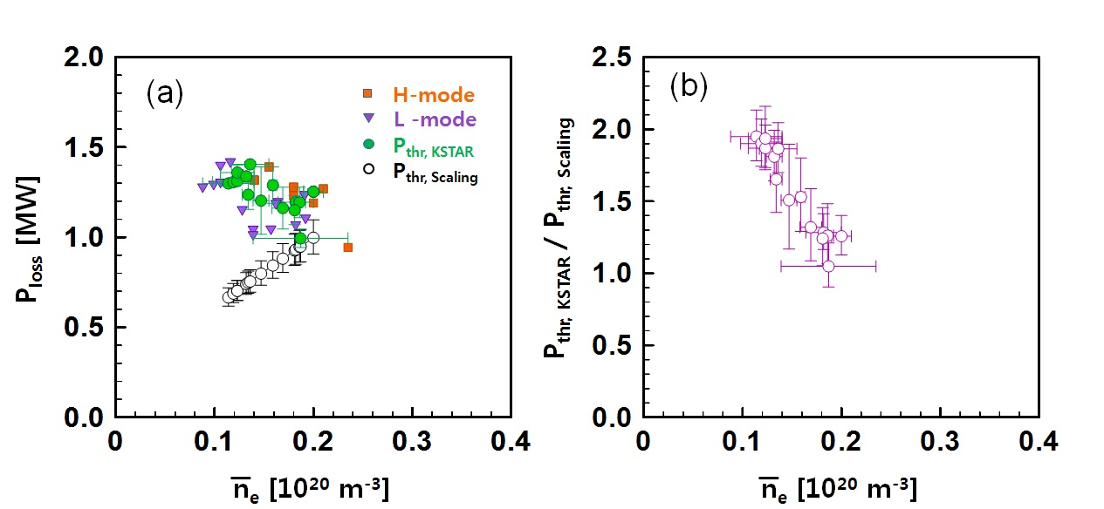
Roll-over of H-mode threshold power at low density
$$P_{thr, scaling}=0.0488±0.0028n_{e20}^{0.717±0.035}B_{T}^{0.803±0.032}S^{0.941±0.019}$$
Progress in ITER Physics Basis (2007)

Slide 8
Energy Confinement Time is in Line with
Multi-Machine Database for L- and H-mode
τ_{E} estimated using measured stored energy and ASTRA simulation with some assumptions
Assuming 20% (due to low density regime) fast ion fraction in the stored energy, the experimental τ_{E} was estimated
  L-mode: τ_{E}= ~86ms, H_{L96}=1.3
  H-mode: τ_{E}=~130ms, H_{H98}=1.1

Slide 9
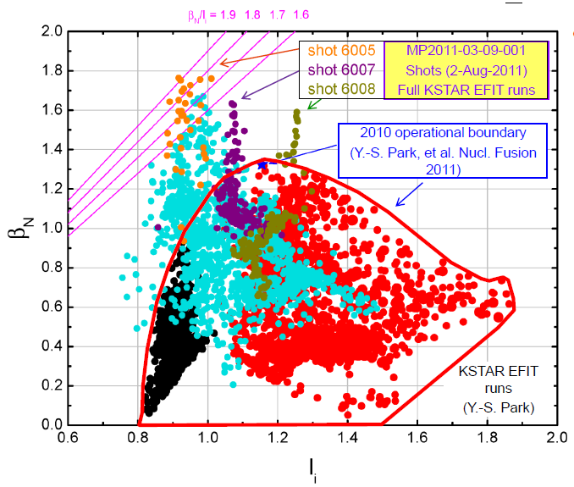
Extended Operation Boundary to high β_{N}

Slide 10
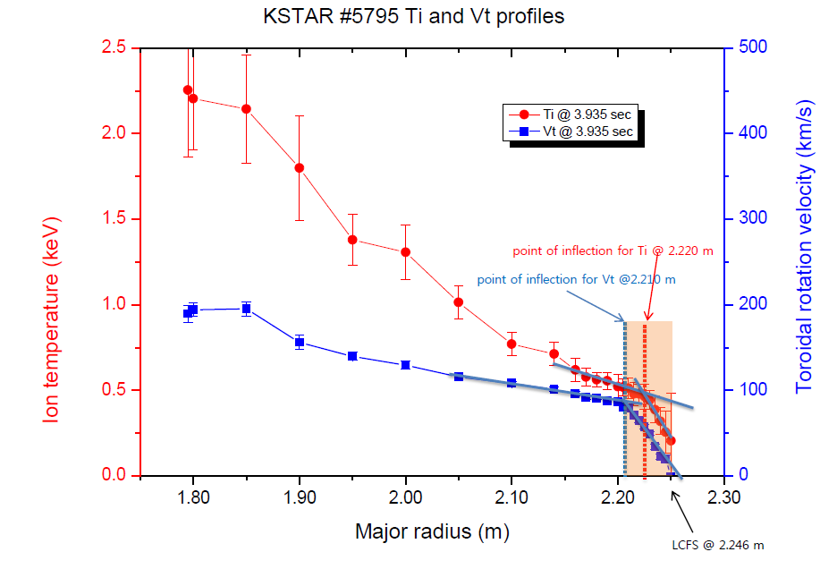
Structure of pedestal from CES measurements
Pedestal width is larger for V_{T}
Width of T_{i} ~2.5 cm
Width of V_{T} ~3.5 cm

Slide 11
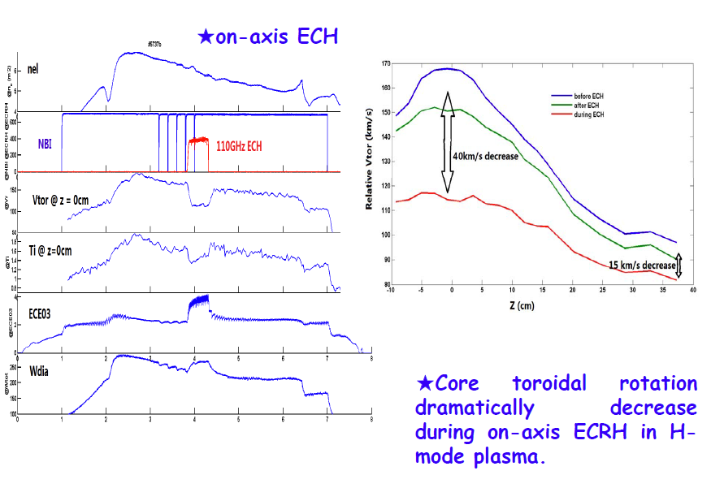
ECH effect on toroidal rotation in H-mode
(by XICS measurements)
Core Ti drop

Slide 12
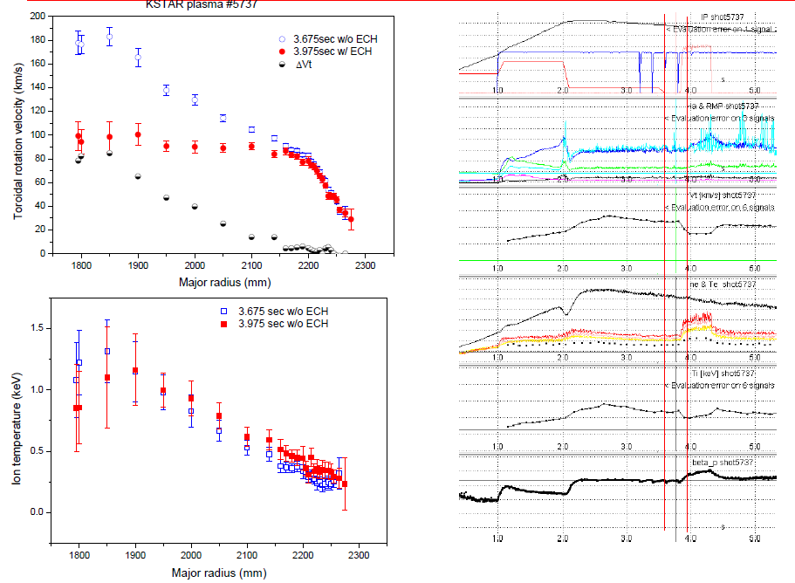
Rotation drop is larger for the central region
CES measurements

Slide 13
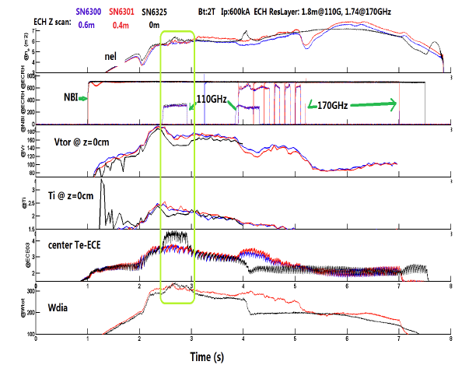
Smaller counter torque with off-axis ECH
Scan of ECH
deposition layer
Smaller drop of T_{i}

Slide 14
Contents
    Short introduction to KSTAR
    H-modes
      L-H transition power threshold
      Characteristics of H-mode discharges
      Effect of ECRH on rotation
    Control of Edge Localized Modes
      Effect of resonant magnetic perturbation
      Direct pedestal heating by ECRH
      ELM mitigation by SMBI
      ELM pacemaking by Vertical jog
    Control of Tearing Modes
14

Slide 15
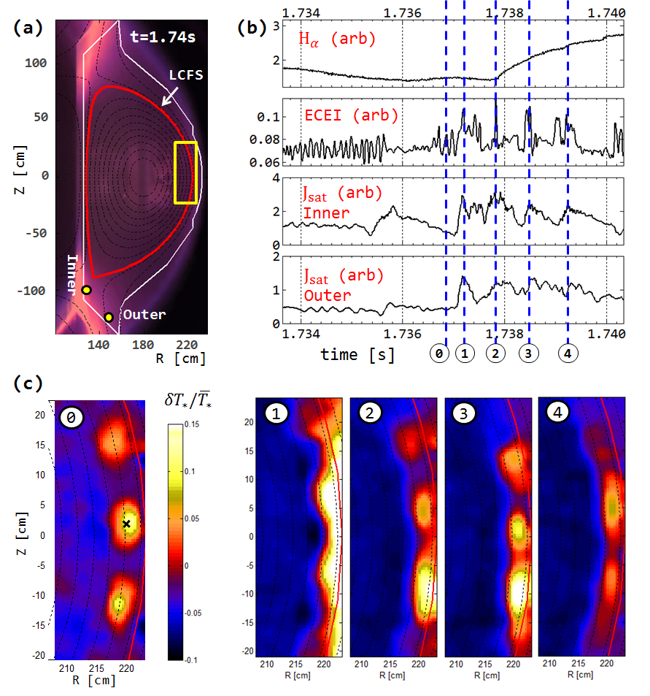
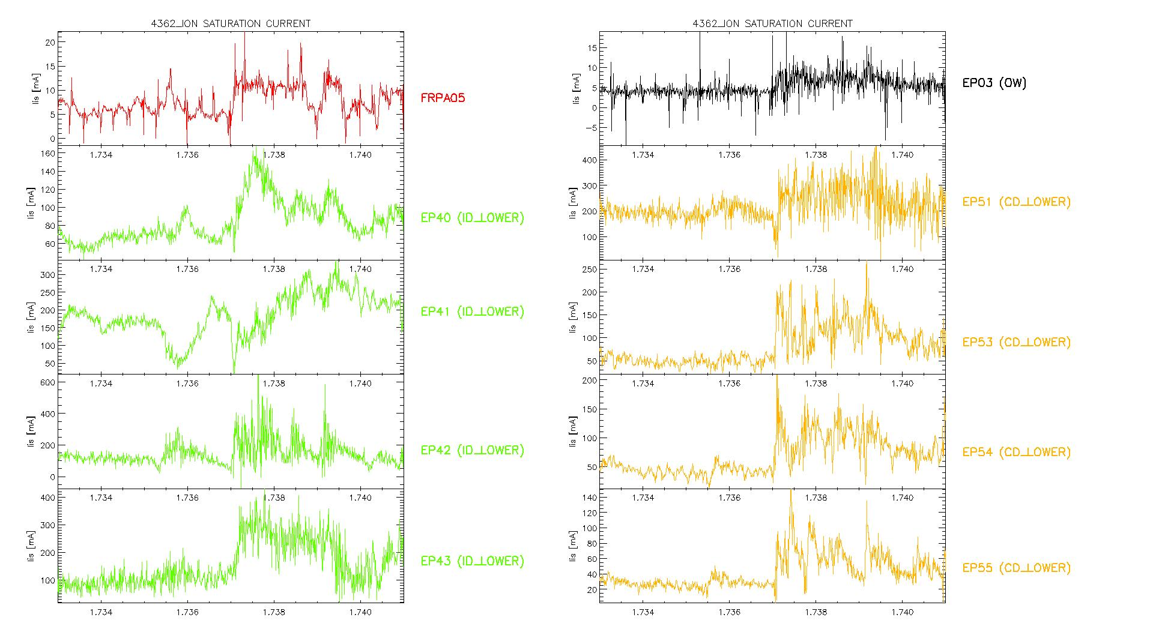
2D ECEI Observation: A Single Large ELM Crash Event Consisted of A Series of Multiple Filament Bursts
A single large ELM crash was composed of a series of multiple filament bursts
Similar observations on ion saturation currents measured from divertor probes
Inner Divertor
(EP 42)
KSTAR #4362
Outer Divertor
(EP 54)
Time [sec]

Courtesy by G.S. Yun (Postech) and J.G. Bak(NFRI)
PRL 2011

Slide 16
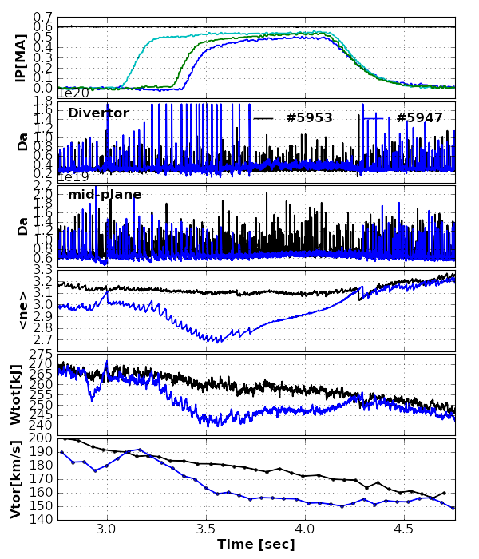
Suppression of ELMs with
n=1 Resonant magnetic perturbations
90 phasing RMP strongly mitigated or suppressed ELMs
In JET, ELM mitigated by n=1 (Y.Liang, PRL, 2007)
Two distinctive phases observed
ELM excitation phase
ELM suppression phase
Density (~10%) pumping out initially. Then, increasing when ELM suppressed
Stored energy drop by ~8% initially. Then slightly increased or sustained when ELM suppressed
Rotation decreased (~10%) initially. Then sustained when ELM suppressed
Te/Ti changes were relatively small
B_{T}=2.0T
P_{NBI}=1.4MW
Top-RMP
Mid-RMP
Bot-RMP

Slide 17
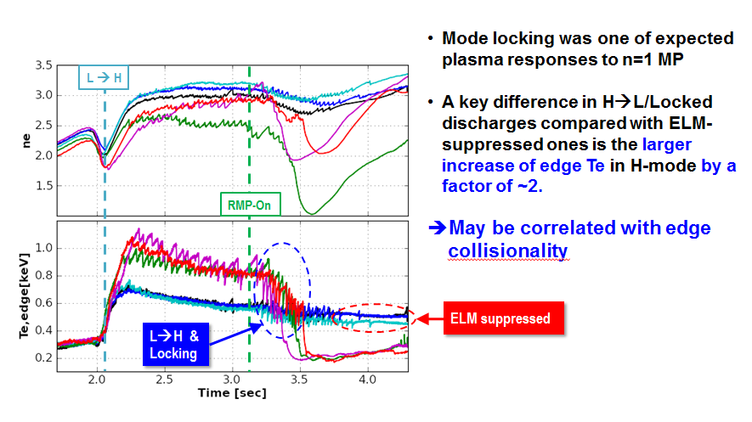
Strong locking observed instead of ELM-Suppression at relatively high edge Te
17

Slide 18
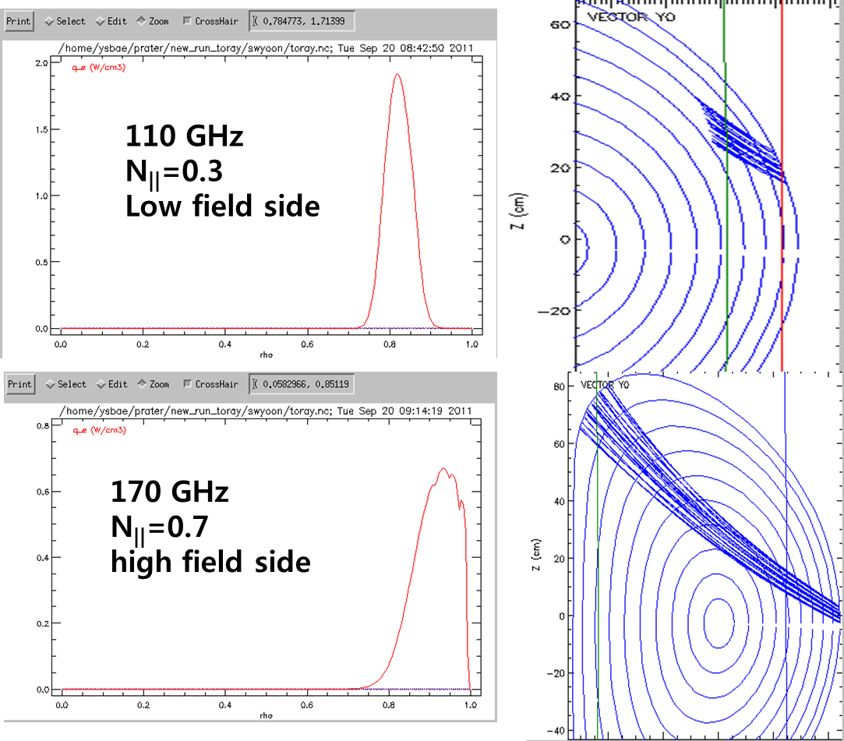
Direct ECH in the pedestal region
Optimal edge
heating
at B_{T0} = 2.3 T

Slide 19
ECH near pedestal increases f_{ELM}
Shot 6313
At relatively low ν*
f_{ELM} before ECH ~20~30 Hz
f_{ELM} during ECH ~40 Hz
f_{ELM} after ECH ~20~30 Hz
Clear n_{e} & V_{T} drop
Similar △W_{ELM}
No clear effect of ECCD

Slide 20
Large ELMs are triggered by ECH
at relatively high ν*

Slide 21
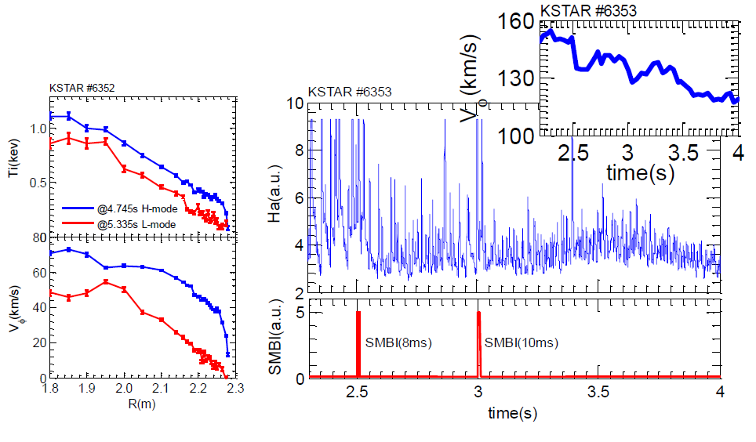
Mitigation of ELMs with Supersonic Molecular Beam Injection
After SMBI injection,
ELM type changed from type-I like to grassy

Slide 22
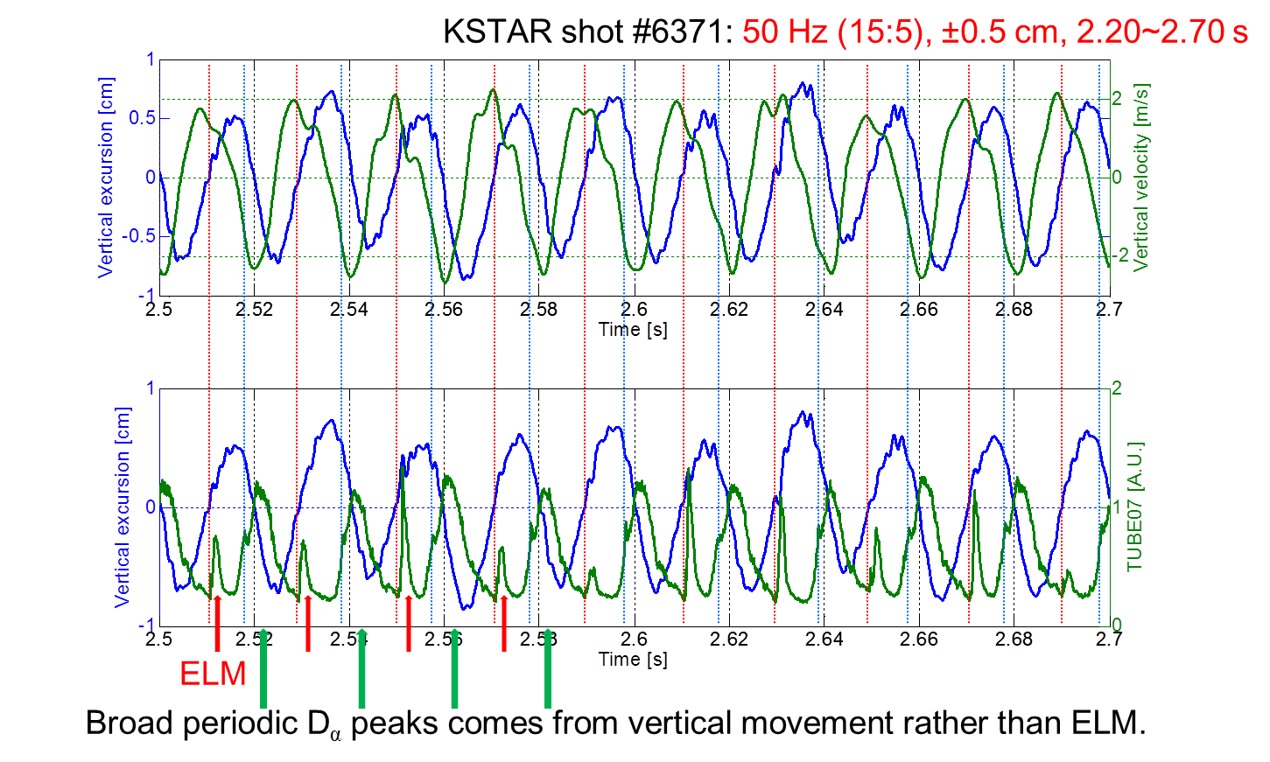
ELM pace-making with fast vertical jog
~5 mm of vertical excursion trigger ELMs (~3 mm is marginal)
ELM is triggered when plasma moves away with its maximum speed

Slide 23
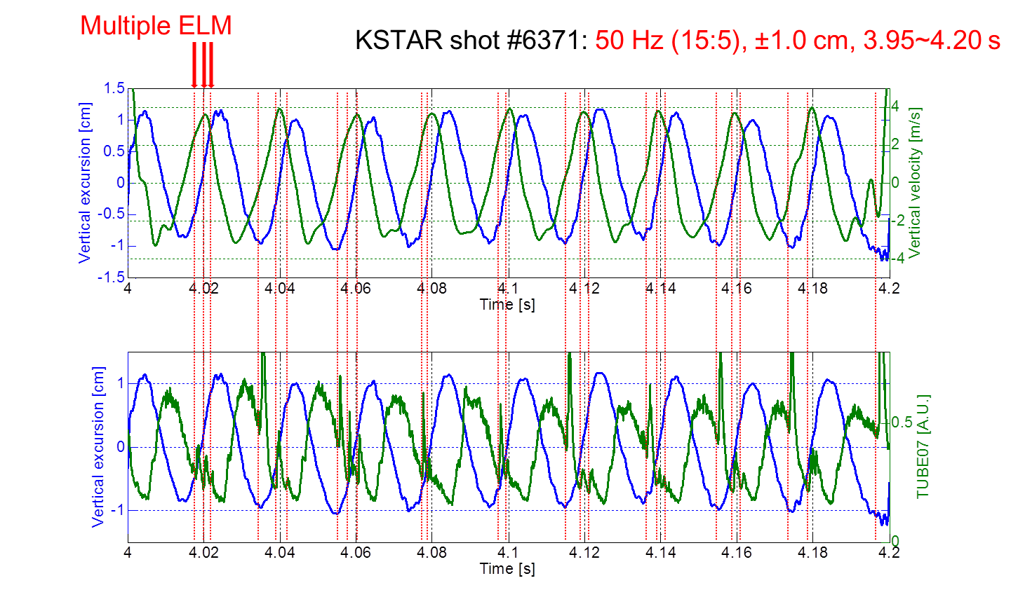
Multiple ELMs triggered with larger excursion
In addition to the normal trigger, larger ELMs are triggered when the vertical position is at lower minimum

Slide 24
Contents
    Short introduction to KSTAR
    H-modes
      L-H transition power threshold
      Characteristics of H-mode discharges
      Effect of ECRH on rotation
    Control of Edge Localized Modes
      Effect of resonant magnetic perturbation
      Direct pedestal heating by ECRH
      ELM mitigation by SMBI
      ELM pacemaking by Vertical jog
    Control of Tearing Modes
24

Slide 25
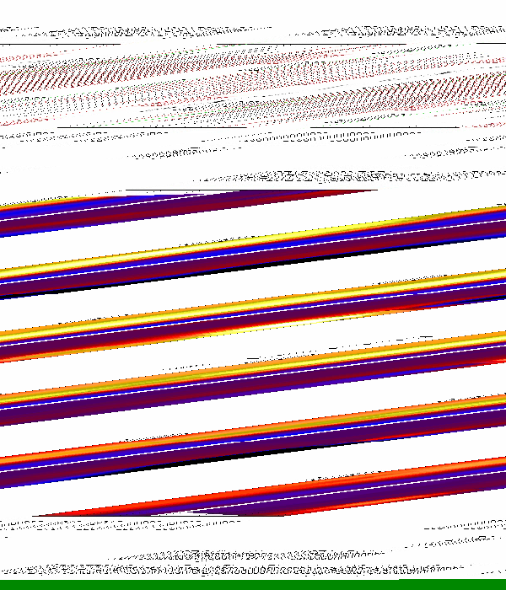
NTM in KSTAR

Slide 26
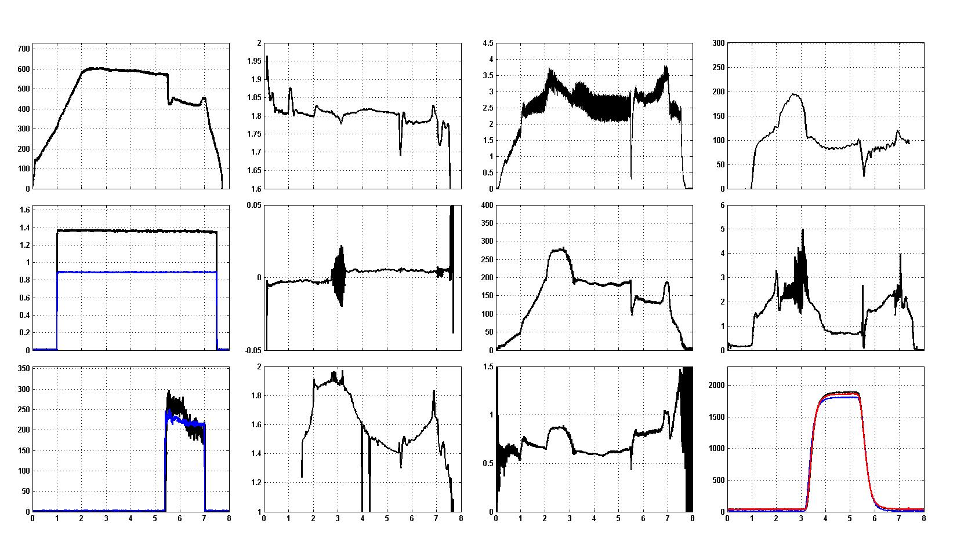
Tearing mode stabilisation experiment
#6272
: m/n=2/1 tearing appears
I_{p} (kA)
R (m)
T_{e} (keV)
V_{tor} (km/s)
NBI (MW)
z (m)
W_{tot} (kJ)
H_{α}
NBI (keV)
170 GHz ECH (kW)
κ
β_{p}
RMP (A)
110 GHz ECH (kW)
Time (s)
Time (s)
Time (s)
Time (s)

Slide 27
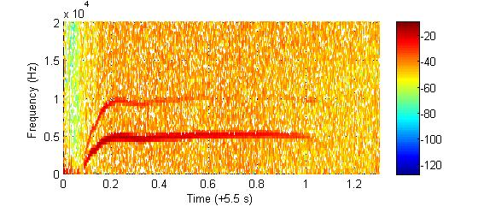
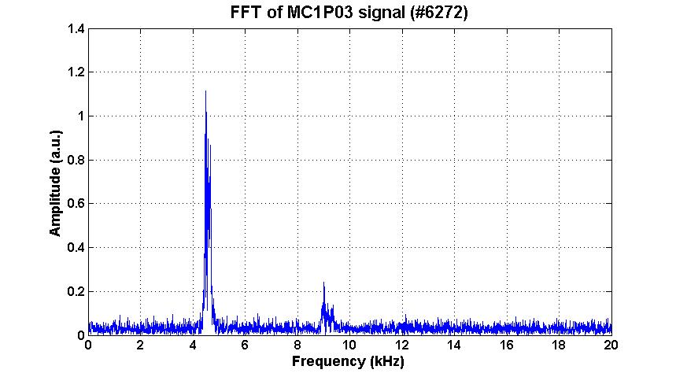
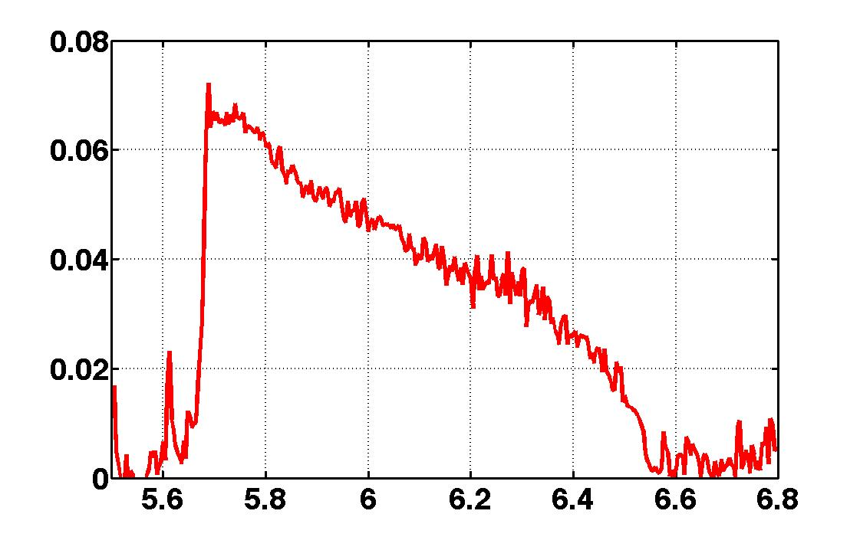
Estimation of Island width from Mirnov coil signals
MC1P03
MC1P03
FFT
4/2 mode
FFT
analysis
2/1 mode
2/1 mode
tracking
4.5
4.6
Island width (m)

Slide 28
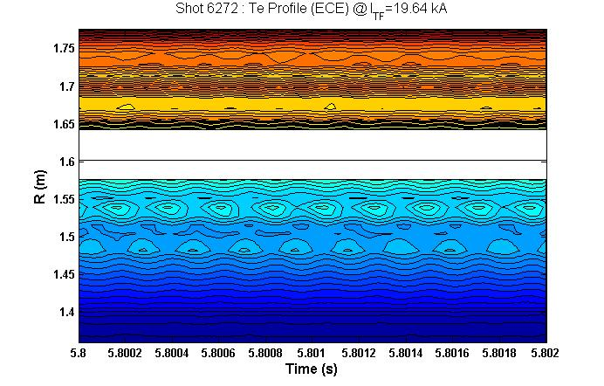
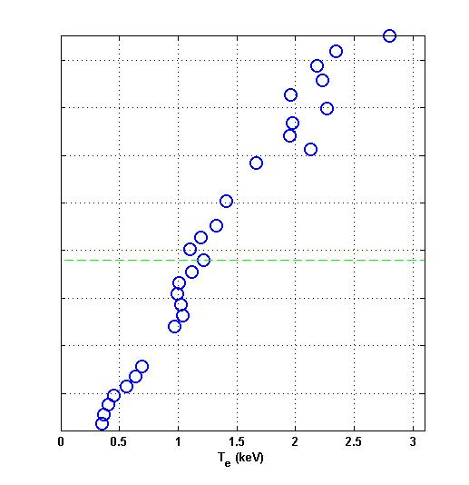
Determination of Island Location using ECE
core
Island width (m)
island
edge
R (m)

Slide 29
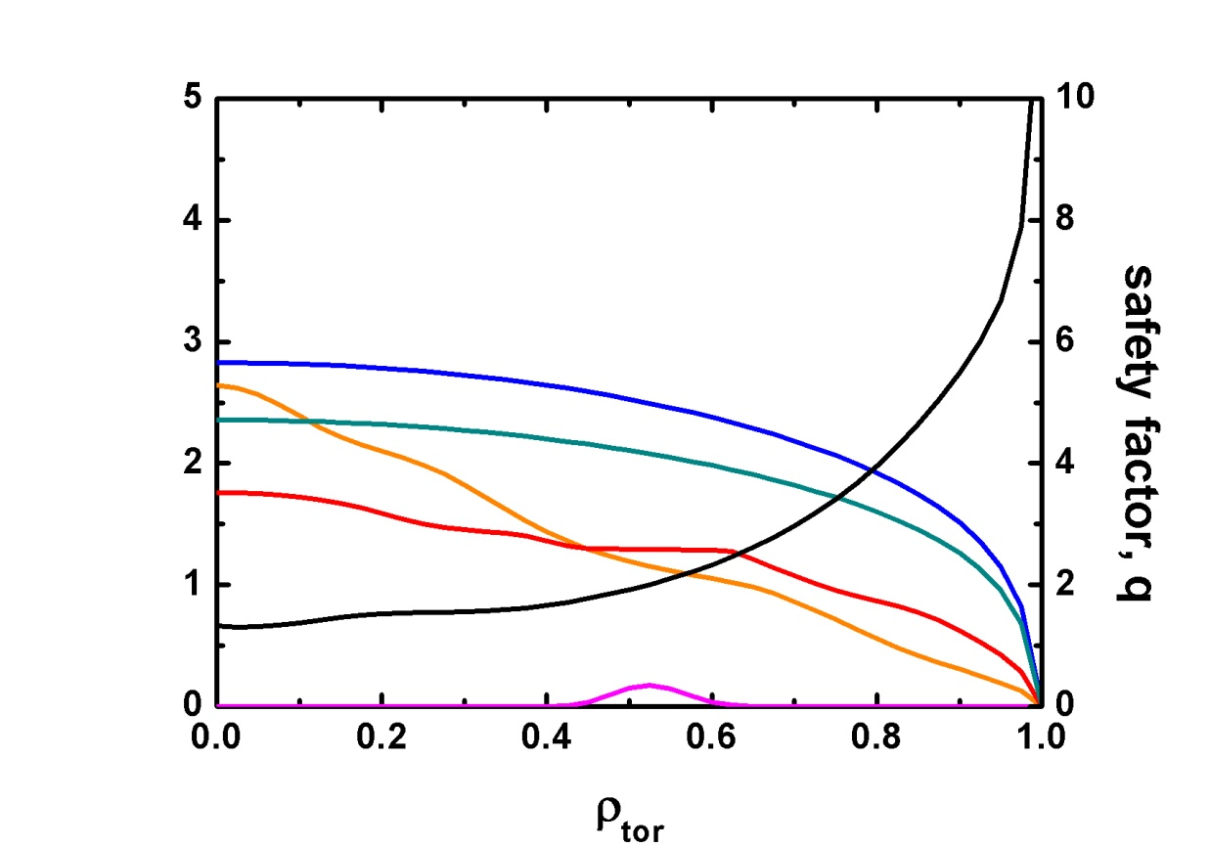
Preliminary simulation of the island evolution
T_{e} From experiment
n_{e}, n_{i} assumed
T_{i} from the Weiland model
Initial width: 0.55 m
Using a₂ = 2
2/1 island
exp.
n_{e} (10¹⁹m⁻³)
Island width (m)
T_{e} (keV)
n_{i} (10¹⁹m⁻³)
Simul.
T_{i} (keV)
P_{ech} (MW/m²)
Time (s)

Slide 30
Strategy for 2012 experiments (Preliminary)
○ Main Research Direction
  Controllable H-mode (> 10 s) at ~1 MA
  ITER relevant/urgent physics issues
  - ELM mitigation by using RMP, SMBI, ECCD, etc
  - IOS-related issues: OPEN!
  Supported by Theory and modelling (ex, WCI)
○ Hardware Priority (mission oriented)
  NB(+2 MW) -> NB(3.5 MW), LH(0.5 MW), ECH(1 MW)
  ICRH(1 MW)
  IRC(In-vessel radial control coil)
  Thomson(25ch), BES, Reflectometry, Diverter IR

Slide 31
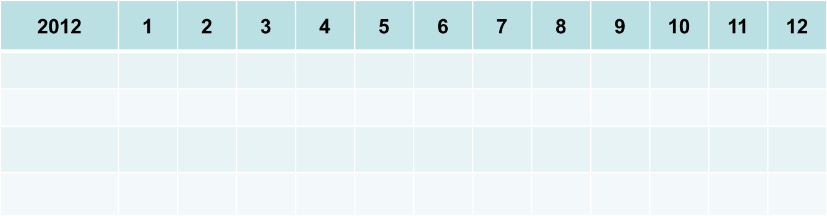
Schedule in 2012(tentative)
Evacuation & Wall conditioning
Magnet cool-down
SC magnet operation
Plasma experiments
August : Evacuation start
Sep. : Cryo-facility operation and magnet cool-down (300 K ~ 4.5 K)
Sep. : SC magnet and power supply operation
Oct. ~ Nov. : Plasma experiments
Dec. : Closing the experiments and magnet warm-up
(*) During Jan. to July, New NBI installation

