Slide 1
Scenario and control modeling for development of DD low-activation ITER operation
T. A. Casper, D. Campbell, Y. Gribov, A. Polevoi and J.A. Snipes
ITER Organization, Route de Vinon sur Verdon, 13115 St Paul Lez Durance, France
ITPA IOS meeting
October 18 – 21, 2011
Kyoto, Japan

Slide 2
A “low activation” scenario for early ITER operation: a controllable scenario with acceptable tritium production?
Operation at half plasma current, I_{P}=7.5MA, and half toroidal magnetic field B_{T}=2.65T with the JCT-2001 controller
Explore issues with early DD operations: performance and activation
15MA inductive case re-defined for 7.5MA study
Same input waveforms – except early heating not required for PF/CS limits and do want to pre-heat neutron flux
Same shapes – inside wall limited and full plasma shape
Assume H-mode access with auxiliary heating, P_{aux}
Initial scenario developed: D as base particle source, T from reaction rates:
DDn: D+D→He³+n⁰ at ~50%
DDp: D+D→T+p⁺ at ~50% - tritium source rate
DT: D+T→He⁴+n⁰ produced T burn up
S_{T}: DDp – DT resulting T particle source rate → N_{T}(φ)
Assume no T diffusion (perfect confinement) to calculate maximum production
Auxiliary heating power and transport assumptions varied
Analytic sources and density profiles for development so far

Slide 3
DD operation: long pulse preceding DT operation and “possible” short pulse for early operations
D Low-activation long pulse case: I_{P}=7.5MA and B_{T}=2.65T (half I_{P}, B_{T})
Candidate for early ITER operation under development
Hydrogen may not make long pulse H-mode, e.g. L-to-H threshold too high
Concern for tritium production
Activation/licensing may limit duration
Use electron heating only
Suppose NBI are not available
Interested in lower current at full field: 10MA, 12MA – no work done
Short pulse D operations rather than H or He to investigate ELM control
Purely “what if” for now – “the Regulator” says no D operation in “non-active” phase
So “not likely” now since it will have to be introduced later in licensing – several of these expected
Must be low activation, so likely 10 to 20 second flattop
Non-activation: H or He operations at reduced I_{P}, B_{T} are main candidates

Slide 4
Simulation with P_{aux}=53MW of electron heating results in T particle inventory of 0.3x10²⁰ after a 400s flattop pulse
(a) Plasma current and auxiliary heating power
Resulting electron and ion temperatures at the magnetic axis using the C-T thermal transport model
(b) On-axis electron density assumed (peak in N_{GW}=.51x10²⁰
Tritium density from reaction rate source: N_{T}~N_{D}/400
Resulting alpha heating P_{alpha} ~ P_{aux}/500
Internal inductance evolution, l_{i3}, vertical stability parameter
Confinement, h_{98y2}, from scaling of C-T model
(c) Rates for nuclear reactions
---------- volume-integrated rate in #/s
*---*---* time-integrated accumulations in #
S is the T particle source: at t = 500s, the total integrated T production is ~ .3x10²⁰ particles ~ .15mg

Slide 5
Assumed and simulated profiles at 450s for flat-top current of I_{P}=7.5MA with P_{aux}=53MW
(a) Input density profiles
N_{e} assumed H-mode electron density profile shape (same as 15MA inductive modeling)
N_{D} is the assumed deuterium
q_{imp}*N_{imp} is the charge-scaled (e.g. fully ionized) impurity assumed to be carbon at N_{C}/N_{D} = .055 → Z_{eff}=1.7
N_{T} is the resulting tritium density profile resulting from the T-particle reaction source rate: N_{T} ~ N_{D}/400
(b) Response profiles using the C-T transport model
Temperature profiles, T_{e} and T_{i}
<J_{T}.B>/<B_{T}/R> is the total flux-surface-averaged current – sawtooth flattening
Safety factor, q

Slide 6
Reaction rates for plasma parameter scans indicates the weak scaling of tritium buildup
Volume integrated rates - particles/s Total integrated source - particles

Slide 7
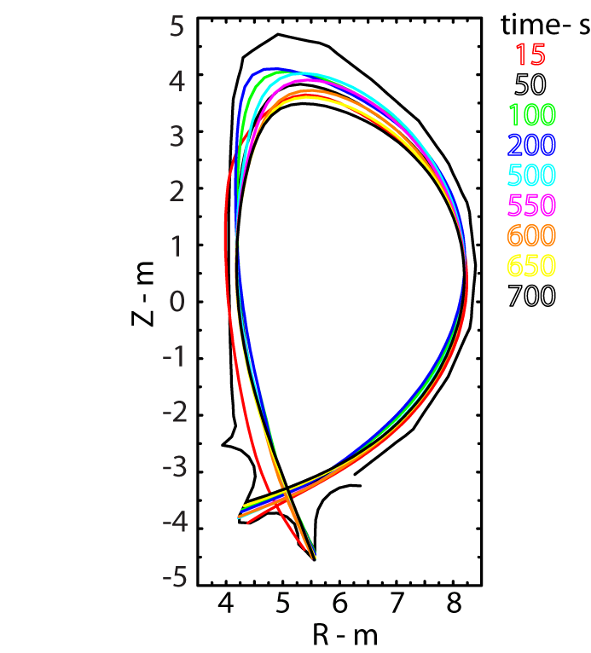
Free-boundary evolution with JCT2001+VS1 controller (from 15MA inductive scenario) maintains plasma shape and vertical position
(a) CS and (b) PF coil currents which are far from allowed limits
(c) CS and (d) PF voltages for feedback control of plasma shape
(e) Fast voltage applied to PF2-PF5 coils for VS1 control of vertical position

Slide 8
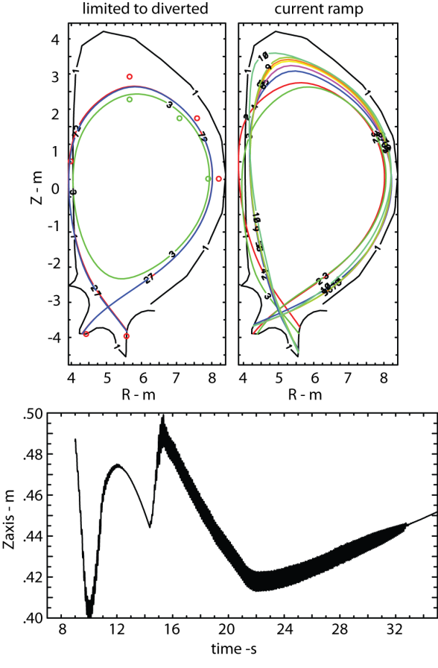
Controller capable of making the transition from inside-wall limited to diverted shapes – shape/position control needs to be optimized
Modification of strike point to pull shape off inside wall
Modification of upper control gap to eliminate poor shape control at full I_{P}

Slide 9
Summary: We have developed a DD scenario for early ITER operation and estimated the tritium production
Developed and initial scenario for operation of ITER at B_{T}/2=2.65T and I_{P}/2=7.5MA with the same assumptions for transport as the 15MA inductive
Simulated control of this scenario was demonstrated was demonstrated with the JCT-2001 controller + VS1 for vertical position
Coil currents and forces are within allowed limits
Estimates of the resulting buildup of tritium give.3x10²⁰ particles per full 400s duration flattop: 0.15mg or .55x10⁵MBq reactivity
Tritium buildup – select reactivity desired
weak function of the heating power (for assumed confinement)
approximately linear with pulse duration
Additional work planned:
Compare with other estimates of tritium production
Turn on transport of produced tritium to develop a true scenario
Source modeling
Operational space

