Slide 1
Integrated Simulation of
Hybrid Scenarios in Preparation for
Feedback Control
Yong-Su Na, Hyun-Seok Kim, Kyungjin Kim, Won-Jae Lee, Jeongwon Lee
Department of Nuclear Engineering
Seoul National University

Slide 2
Contents
  Simulation Setup
  - ELM
  - NTM
  - Momentum Transport
  Momentum Transport Simulation
  ELM Simulation
  - Sensitivity analysis
  - Small ELM event
  - Ideal MHD analysis
  NTM Simulation
  Real-time Control Simulation of NTM in KSTAR
  - Model validation
  - Feedback control simulation
  ELM Control by Pellets

Slide 3
Simulation Setup
Based on the hybrid benchmark guideline
Plasma in a flattop phase (as stationary as possible)
Density prescribed. Solving the heat transport in the whole plasma.
Solving momentum transport ρ = 0-0.9
I_{p} | 12 | MA
B_{T} | 5.3 | T
τ_{P}*/τ_{E} | 5.0
f_{D}/(f_{D}+f_{T}) | 0.5
f_{Be} | 2 | %
f_{Ar} | 0.12 | %
P_{NBI} | 33 | MW
P_{ICRF} | 20 | MW
P_{EC} | 20 | MW
R_{b}, z_{b} for fixed boundary

Slide 4
Simulation Setup
Heat transport coefficients
- Inside the magnetic island
χ_{e,i} = F_{χ,NTM} (NTM transport Enhancement Factor)
: Arbitrary constant value
- In the pre-ELM phase
- For ρ = 0.0-0.925
χ_{e,i} = χ_{e,i}^{NEO} + χ_{e,i}^{ITG/TEM} + χ_{e,i}^{RB} + χ_{e,i}^{KB}
- For ρ = 0.925-1.0
χ_{e,i} = χ_{e,i}^{NEO}
: MMM95
- In the ELM burst phase
- For ρ = 0.0-0.925
χ_{e,i} = χ_{e,i}^{NEO} + χ_{e,i}^{ITG/TEM} + χ_{e,i}^{RB} + χ_{e,i}^{KB}
- For ρ = 0.925-1.0
χ_{e,i} = F_{χ,ELM} (ELM transport Enhancement Factor)
: Arbitrary constant value

Slide 5
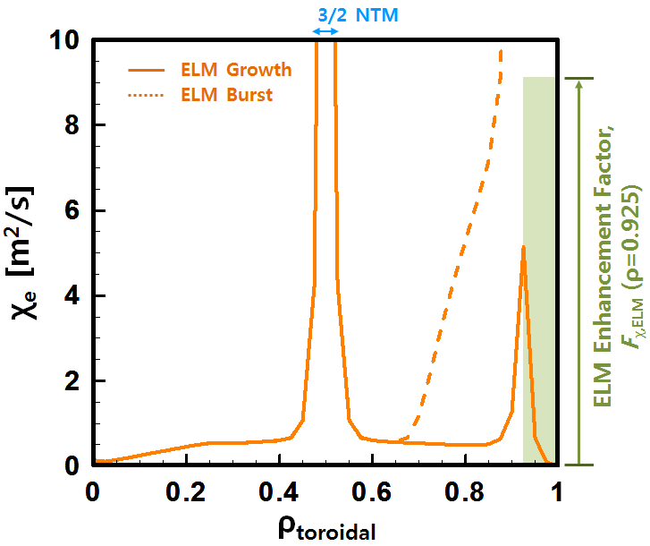
Simulation Setup
Heat transport coefficients
- Inside the magnetic island
χ_{e,i} = F_{χ,NTM} (NTM transport Enhancement Factor)
: Arbitrary constant value
- In the pre-ELM phase
- For ρ = 0.0-0.925
χ_{e,i} = χ_{e,i}^{NEO} + χ_{e,i}^{ITG/TEM} + χ_{e,i}^{RB} + χ_{e,i}^{KB}
- For ρ = 0.925-1.0
χ_{e,i} = χ_{e,i}^{NEO}
: MMM95
- In the ELM burst phase
- For ρ = 0.0-0.925
χ_{e,i} = χ_{e,i}^{NEO} + χ_{e,i}^{ITG/TEM} + χ_{e,i}^{RB} + χ_{e,i}^{KB}
- For ρ = 0.925-1.0
χ_{e,i} = F_{χ,ELM} (ELM transport Enhancement Factor)
: Arbitrary constant value

Slide 6
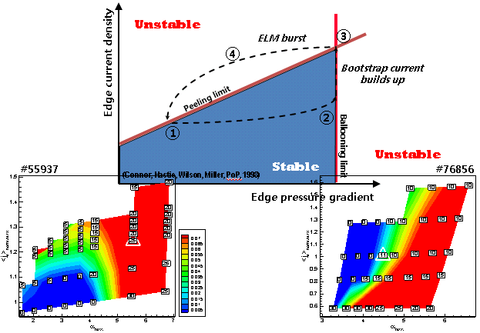



Simulation Setup
Hyunsun Han et al., ITPA IOS 2010, Seoul, Korea
ELM criterion

Slide 7
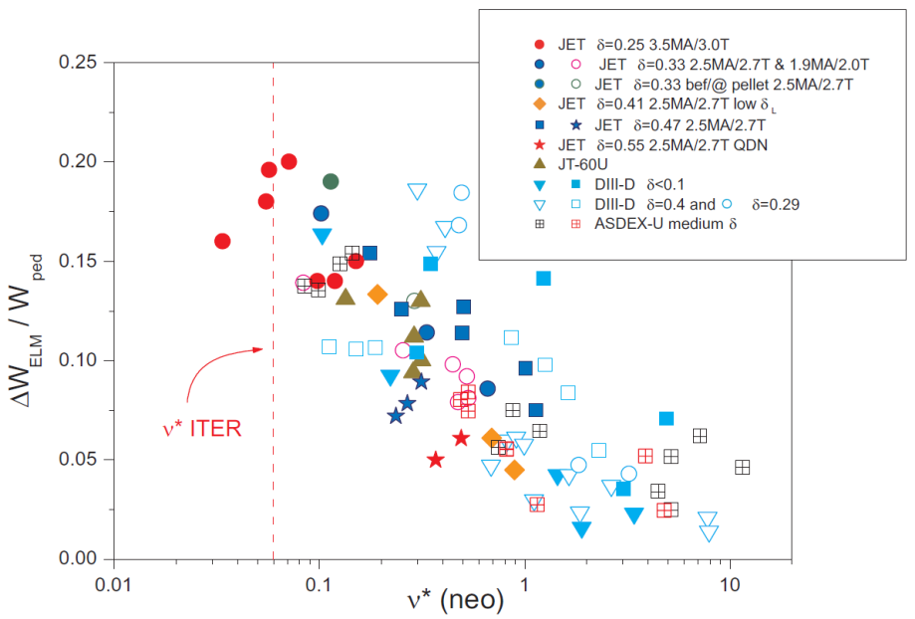
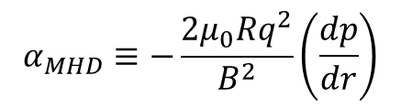


Simulation Setup
[1] H.R Wilson et al., NF 40 713 (2000)
ELM criterion
[2] Presented by C. Kessel in ITPA-SSO (2005)
$$α_{MHD}≡−\frac{2μ_{0}Rq^{2}}{B^{2}}\left(\frac{dp}{dr}\right)$$
[3] A. Loarte et al., PPCF 45 1549 (2003)
[1]
[2]
$$α_{c}≡0.4s\left(1+{κ95}_{}^{2}\left(1+5{δ95}_{}^{2}\right)\right)$$
$κ95=1.75$, $δ95=0.50$
F_{χ,ELM}(ρ=0.925) ~ 200
[3]

Slide 8
Simulation Setup
The Modified Rutherford Equation (MRE) for NTMs

Slide 9
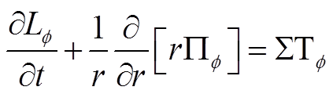
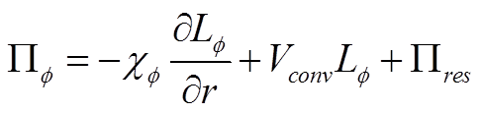

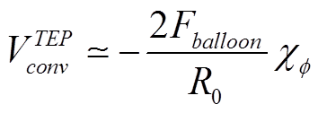

Momentum Transport Equation
Toroidal angular momentum transport equation^{[1]}
Toroidal Reynolds stress^{[1]}
Momentum diffusivity^{[2]}
Turbulent Equipartition pinch^{[3]}
Residual stress^{[4,5]}
[1] P.H. Diamond et al., NF 49 045002 (2009)
[2] S.D. Scott et al., PRL 64 531 (1990
[3] T.S. Hahm et al., PoP 14, 072302 (2007)
[4] M. Yoshida et al., PRL 100 105002 (2008)
[5] M. Yoshida et al., 23rd IAEA-FEC, Dajeon Korea (Oct, 2010)

Slide 10
Momentum Transport Equation
Toroidal angular momentum transport equation^{[1]}
Toroidal Reynolds stress^{[1]}
Momentum diffusivity^{[2]}
Turbulent Equipartition pinch^{[3]}
Residual stress^{[4,5]}
[1] P.H. Diamond et al., NF 49 045002 (2009)
[2] S.D. Scott et al., PRL 64 531 (1990
What could be a reasonable boundary condition?
[3] T.S. Hahm et al., PoP 14, 072302 (2007)
[4] M. Yoshida et al., PRL 100 105002 (2008)
[5] M. Yoshida et al., 23rd IAEA-FEC, Dajeon Korea (Oct, 2010)

Slide 11
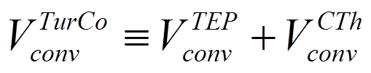
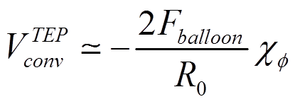
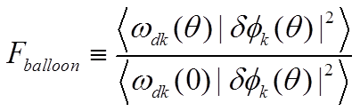
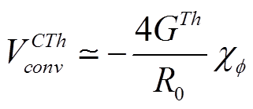
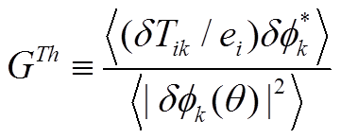
Turbulence driven convective pinch velocity
TEP(Turbulent Equipartition Pinch) velocity
F_{balloon} quantifies the ballooning mode structure of the turbulence.
Typical outward ballooning flucturations(peaked at the low-B side), F_{balloon} ~1>0
CTh(Curvature driven Thermal) flux
G^{Th} quantifies the relative strength of contributions from ion temperature fluctuations related to the curvature driven thermoelectric effect.
T. S. Hahm et al., PoP 14 072302 (2007)

Slide 12
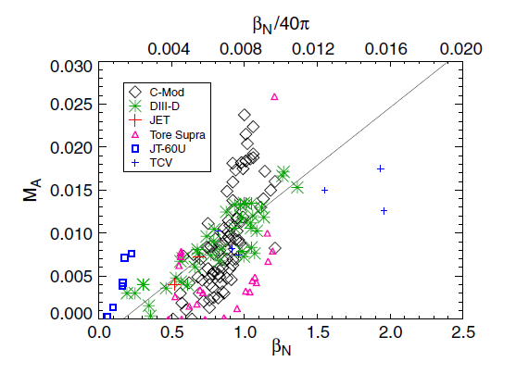
Intrinsic Rotation :
Rice scaling for ITER extrapolation
M_{A} = v_{tor}/C_{A}
No NBI or negligible
momentum input
ß_{N} =1.9 ~ 2.2
J.E. Rice et al, NF 47 1618 (2007)

Slide 13
Intrinsic Rotation :
Rice scaling for ITER extrapolation
M_{A} = v_{tor}/C_{A}
No NBI or negligible
momentum input
ß_{N} =1.9 ~ 2.2
 | Measurement point
JET | r/a ~0.35
C-Mod | r/a ~0.0 (flat profile)
Tore Supra | r/a <0.17
DIII-D | r/a ~0.8 (q=2 surface)
TCV | r/a ~0.6-0.7 (q=2 surface)
JT-60U | r/a ~0.25 (flat profile)
J.E. Rice et al, NF 47 1618 (2007)

Slide 14
Intrinsic Rotation :
Rice scaling for ITER extrapolation
M_{A} = v_{tor}/C_{A}
No NBI or negligible
momentum input
ß_{N} =1.9 ~ 2.2
M_{A} ~ 0.025
near q = 2 surface
Find expected
boundary condition
for the ITER
intrinsic rotation
velocity
J.E. Rice et al, NF 47 1618 (2007)

Slide 15
B.C. Scan for Rice Scaling
M_{A}
q
B.C. 0.014
B.C. 0.01
B.C. 0.006
Without NBI torque
M_{A} ~ 0.025
near q=2 surface
Used for scans
B.C. at ρ=0.9
→ M_{A0.9} ~ 0.01
ω = 14.5 kRad/s
v_{TOR} = 90 km/s
accords with the
scaling
ρ

Slide 16
B.C. Scan for RWM Suppression
M_{A}
RWM suppression
requirements:
- M_{A} ~ 0.02-0.05
at the centre for
peaked profiles
B.C. 0.01
B.C. 0.006
B.C. 0.004
B.C. 0.002
M_{A0.9} ≥ 0.0034
ω ≥ 4.8 kRad/s
v_{TOR} ≥ ~ 30 km/s
for suppression
of RWM
Used as reference
→ Enough rotation
to suppress RWM
with M_{A0.9} ~ 0.01?
ρ
Yueqiang Liu et al, NF 44 232 (2004)

Slide 17
Prandtl Number Scan
M_{A}
ω (kRad/s)
Pr 0.5
Pr 1.0
Pr 1.5
Profile NOT sensitive to Prandtl number due to pinching flux
ρ

Slide 18
Convective Momentum Pinch Scan
M_{A}
ω (kRad/s)
F_{balloon} 2.0
F_{balloon} 1.5
F_{balloon} 1.0
Profile sensitive to Convective momentum pinch
ρ

Slide 19
Residual Stress Scan
M_{A}
ω (kRad/s)
α_{k} 0
α_{k} 0.5α
α_{k} 1.0α
Profile not so sensitive to the coefficient of the Residual stress term
ρ

Slide 20
Counter Torque by ICRH
Work being done by Dr. B.H. Park (NFRI)
We calculated the momentum transfer from RF waves.
The total toroidal force is much larger than the total poloidal force.
Even though the total poloidal force is negligible there is strong shear torque near MC layer.
The total force is almost proportional to the toroidal wave number and the RF power.
The direction of the force is strongly dependent on antenna phase.
In toroidal force, the dependence on the minority concentration is not clear but the poloidal shear force is strongly depend on minority concentration.

Slide 21
Counter Torque by ICRH
n_{e} = 5×10¹⁹ m⁻³
Force on last flux surface
TOROIDAL
H-minority
³He-minority
H-minority
POLOIDAL
³He-minority
Toroidal force strongly depend on antenna phase and large than poloidal force.

Slide 22
Counter Torque by ICRH
H-minority
n_{e} = 5×10¹⁹ m⁻³
Toroidal & Poloidal Force Profile
TOROIDAL
POLOIDAL
Toroidal force is smooth function of minor radius and almost monotonically increases as y increases. Input poloidal force is small but it possibly makes strong shear flow near MC regime.

Slide 23
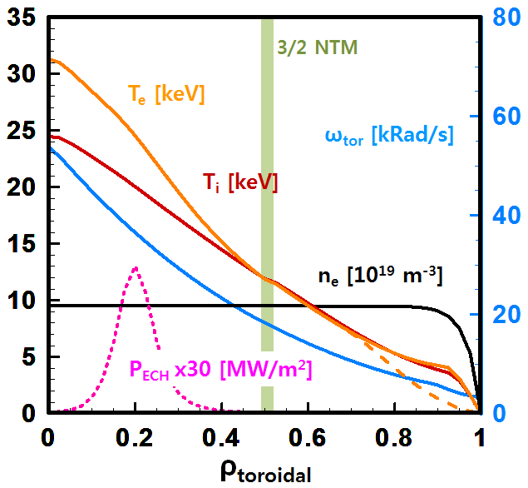
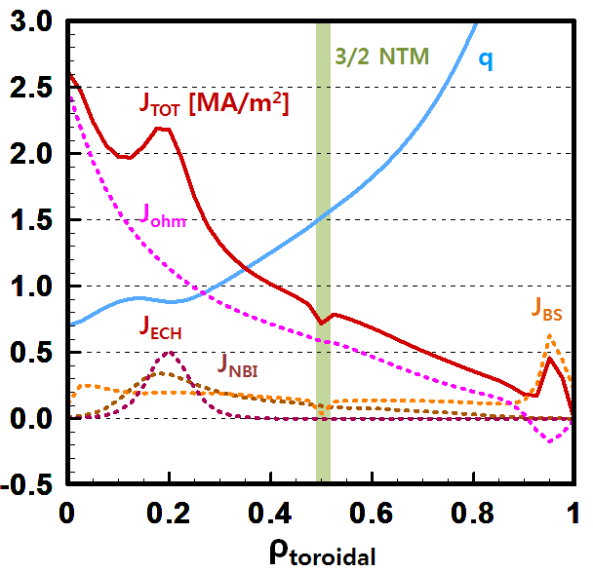
Plasma Profiles with NTM and ELM
@ ~550 s
After ELM burst

Slide 24
Time Trace of ELMs
T_{e} [keV]
T_{i} [keV]
Simulation Time [s]

Slide 25
ELM Characteristics Studies
1. Scan of ELM enhancement factor; F_{χ,ELM}(ρ=0.925)
F_{χ,ELM}(ρ=0.925)
= 200, 400, 600,
800, 1000

Slide 26
ELM Characteristics Studies
1. Scan of ELM enhancement factor; F_{χ,ELM}(ρ=0.925)
2. Scan of ELM crash duration; t_{ELM,Crash}
t_{ELM,Crash}
: 1 ms, 2 ms
t_{ELM,Crash}
t_{between ELMs}
T_{e} [keV]
Simulation Time [s]

Slide 27
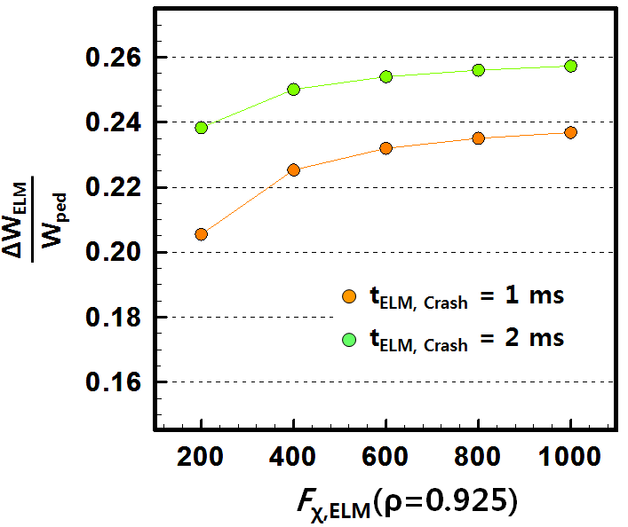
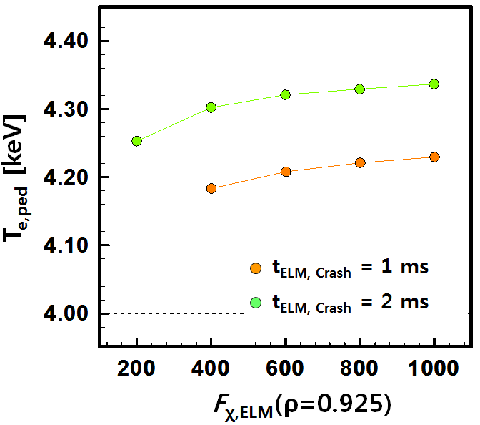
Results of ELM characteristics (1)
@ ~550 s
@ ~550 s

Slide 28
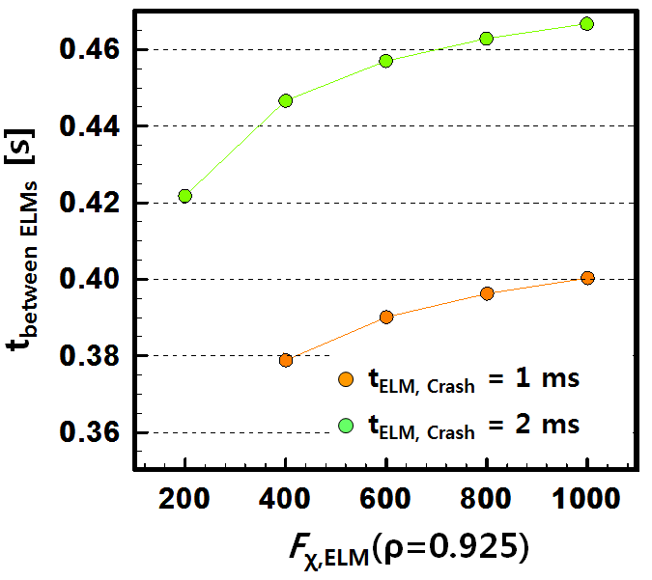
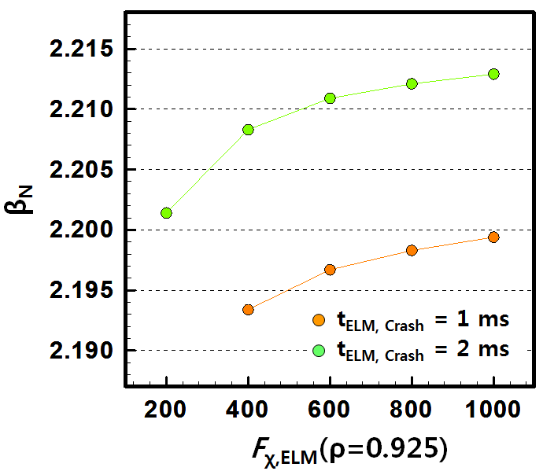
Results of ELM characteristics (2)
@ ~550 s
@ ~550 s

Slide 29
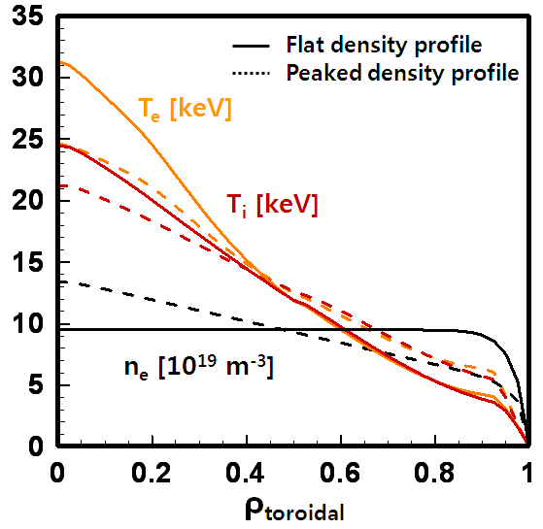
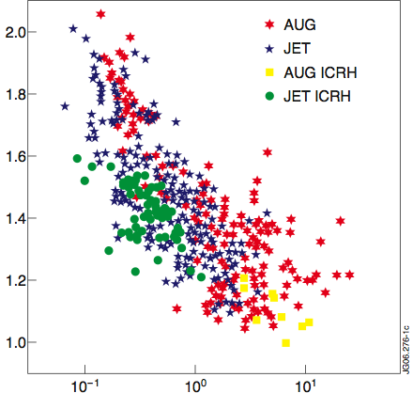
Density Profile Scan
@ ~550 s
n₀/<n>_{vol}
ITER
ν_{eff}
H. Weisen et al, IAEA (2006)
C. Angioni et al, NF 47 1326 (2007)
Density peaking factor ~ 1.7

Slide 30
Density Profile Scan
@ ~550 s
 |  | Flat n_{e} Profile | Peaked n_{e} Profile | unit
V_{tor} | Pr | 1 | 1
 | F_{balloon} | 4 | 4
 | Residual | 0.5 | 0.5
 | B.C. @ ρ=0.9 | 0.004 | 0.004
T_{i} / T_{e} @ ρ=0.0 |  | 24.5 / 31.3 | 21.3 / 24.7 | keV
T_{i} / T_{e} @ ρ=0.925 |  | 3.66 / 4.17 | 5.63 / 6.32 | keV
n_{e} @ ρ=0.0 |  | 9.5 | 13.4 | 10¹⁹ m⁻³
n_{e} @ ρ=0.925 |  | 8.68 | 5.3 | 10¹⁹ m⁻³
β_{N} |  | 2.19 | 2.27
Q |  | 5.2 | 5.2
I_{BS} |  | 3.48 | 3.95 | MA
I_{NBI} |  | 1.33 | 1.46 | MA
I_{ECR} |  | 0.408 | 0.409 | MA
IPL |  | 12 | 12 | MA
q(0) |  | 0.702 | 0.714

Slide 31
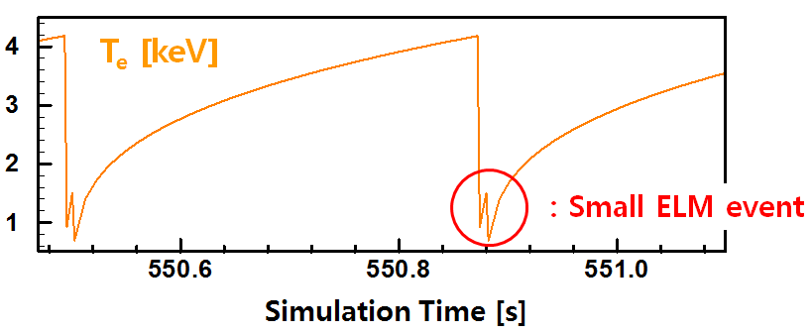
Small ELM Event

Slide 32
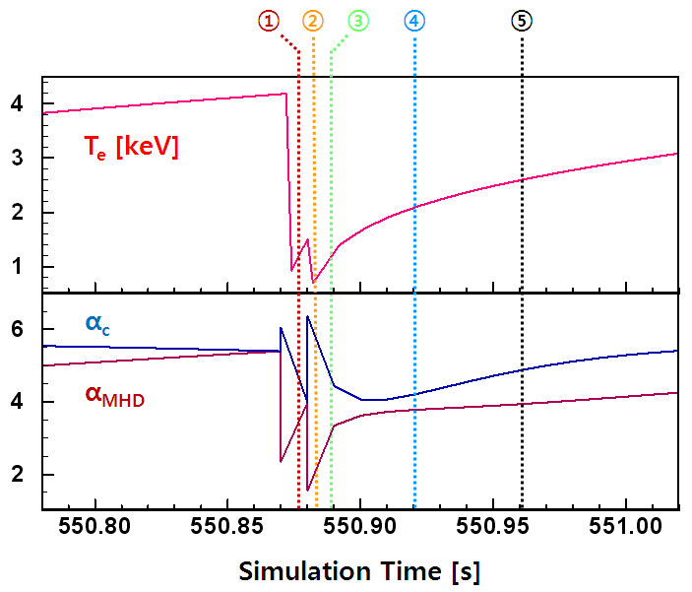
α_{c} and α_{MHD} During the Events

Slide 33
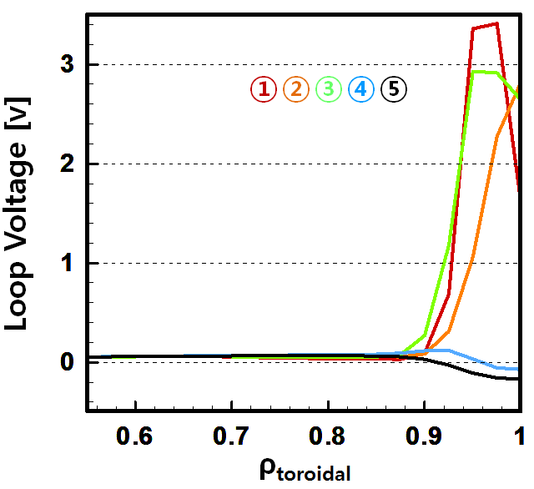
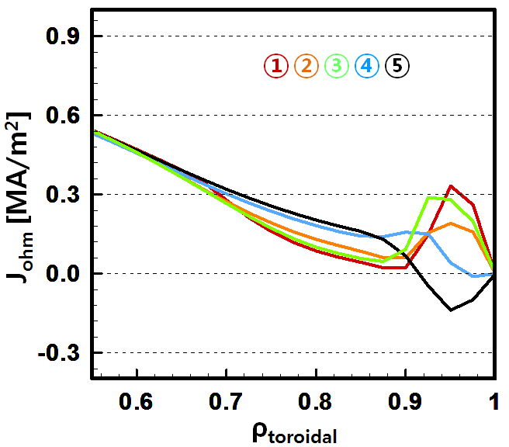
Effect of Loop Voltage Variation
@ ~550 s
@ ~550 s
①
②
③
④
⑤
T_{e} [keV]
Simulation Time [s]

Slide 34
Ideal MHD Stability Analysis
Helena^{[1]}
  2D fixed boundary equilibrium solver using finite element method
ELITE^{[2]}
  2D eigenvalue code using the energy principle
  Difficult to handle reversed shear configurations
MISHKA^{[3]}
  Can handle reversed shear configurations
  Not enough poloidal harmonic number m:
  weakness of the edge calculation
[1] G.T.A. Huysmans et al, Proc. CP90 Conf. Computational Physics, Amsterdam (1991)
[2] P.B. Snyder et al PoP 9 2037 (2002)
[3] A.B. Mikhailovskii et al, Plasma Phys. Rep. 23 844 (1997)

Slide 35
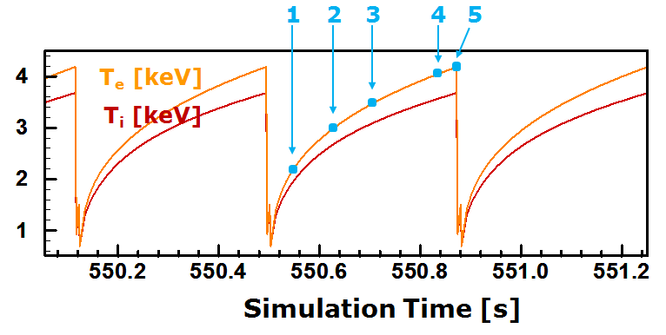
Ideal MHD Stability Analysis
5 equilibrium point in an ELM cycle → j – α scan for stability analysis

Slide 36
Ideal MHD Stability Analysis
1
5
<j>_{max}
2
4
3
γ/ω₀ = 0.01
α

Slide 37
Simulation Setup
Hyunsun Han et al., ITPA 2010, Seoul, Korea
ELM criterion

Slide 38
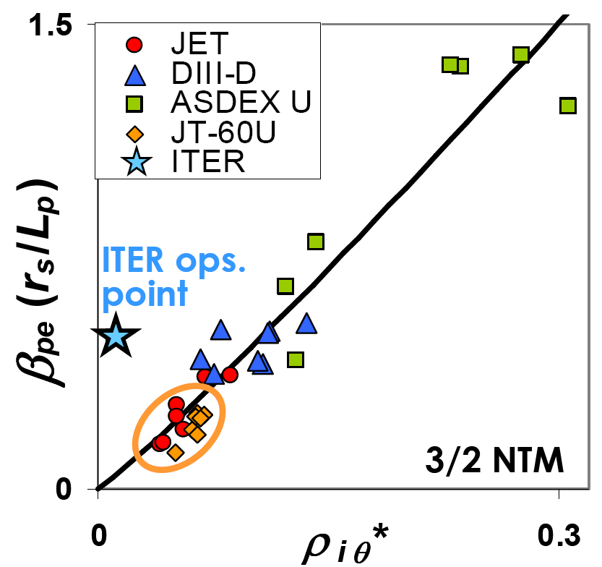
NTM Onset Criteria & Stability Diagram
cf) ITER ops. point
→ ITER H-mode scenario 2
* Buttery R.J. et al 2004 IAEA FEC (Vilamoura, 2004) (Vienna: IAEA)
CD-ROM file EX/7-1

Slide 39

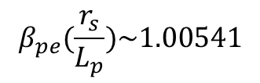

NTM Onset Criteria & Stability Diagram
At $t=520 s$,
$$β_{pe}(\frac{r_{s}}{L_{p}})\sim 1.00541$$
ITER simul.
point
with ${ρ_{iθ}^{}}^{∗}\sim 0.001$
cf) ITER ops. point
→ ITER H-mode scenario 2
* Buttery R.J. et al 2004 IAEA FEC (Vilamoura, 2004) (Vienna: IAEA)
CD-ROM file EX/7-1

Slide 40
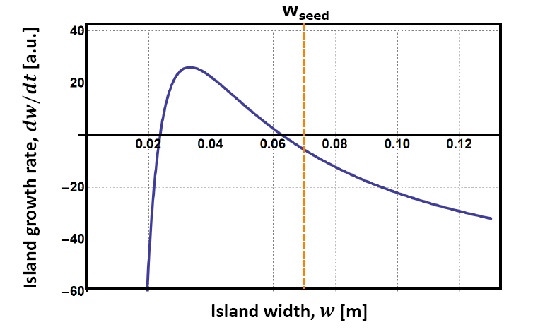
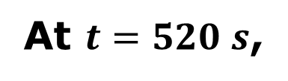
NTM Onset Criteria & Stability Diagram
At $t=520 s$,

Slide 41
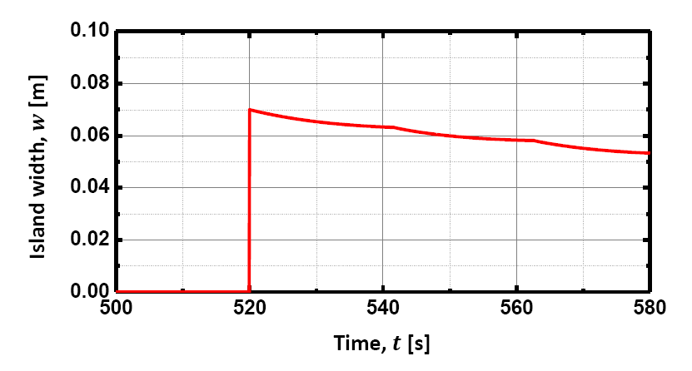
Time Evolution of the Island Width

Slide 42
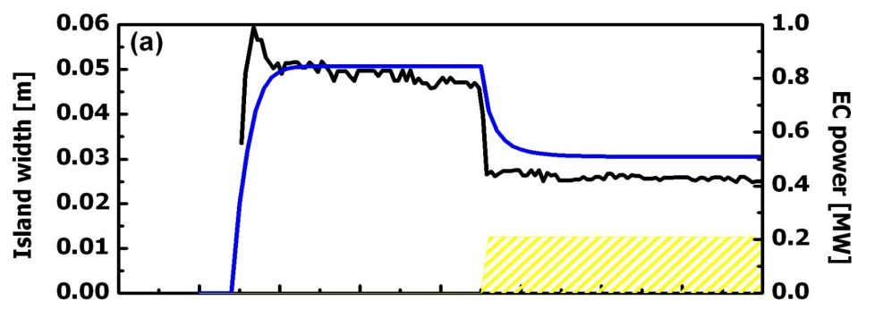
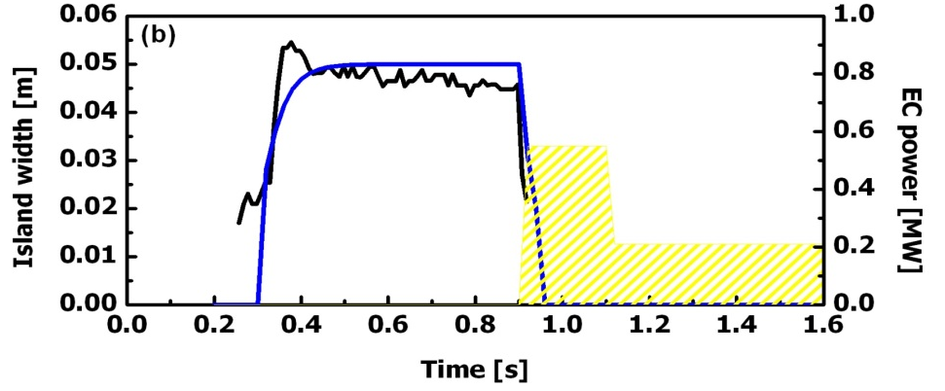
Validation of the Modelling Tool
TCV: (2,1) stabilisation by ECH in OH plasmas
#40539
#40543
Time (s)
Time (s)
K.J. Kim et al, EPS (2011)

Slide 43

Validation of the Modelling Tool
ASDEX Upgrade: (3,2) stabilisation by ECCD
#21133
#25845
Time (s)
Time (s)
Yong-Su Na et al, IAEA (2010)

Slide 44
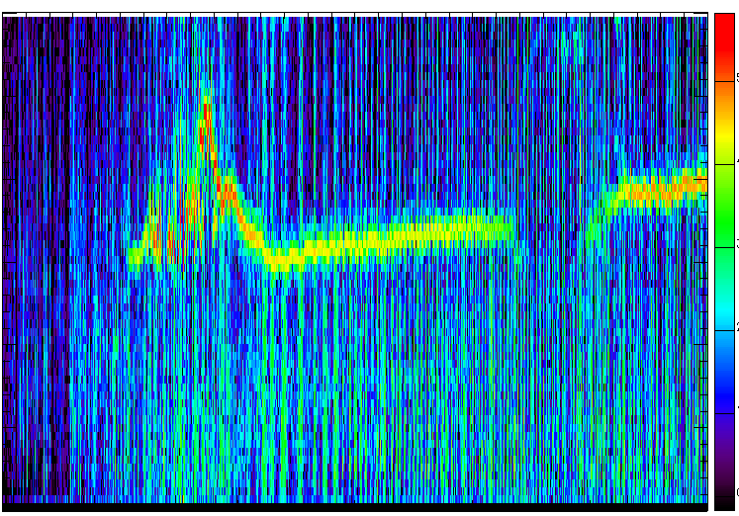
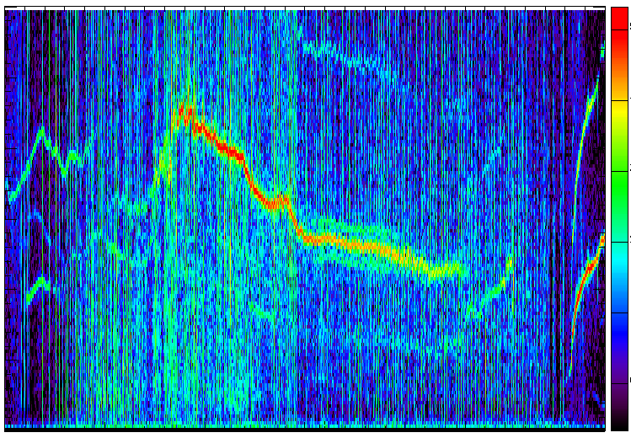
Validation of the Modelling Tool
ASDEX Upgrade: (3,2) stabilisation by ECCD
Yong-Su Na et al, IAEA (2010)

Slide 45
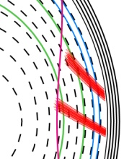
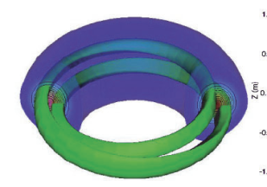
Real-time Feedback Control of NTMs in KSTAR
plasma
response
Launcher angle
controller
Island width
Location of Island
P_{ECH}
ECH & ECCD
T_{e}
j_{ECCD}
q
j_{bs}
j_{OH}
j
Alignment between NTM and ECCD
To control the NTM
Replacing the missing bootstrap current inside island
by localised external current drive

Slide 46
System Identification
Defining the input and the output parameter
The input parameter: the poloidal angle of the ECCD launcher
The output parameter: the width of the (3,2) island
Simulation by ASTRA with/without modulation of the input parameter
Pseudobinary noise modulation applied
Creating a database for the difference between with and without modulation case
Reference case: without ECCD as well as without modulation
plasma
response
the poloidal angle
of the ECCD launcher
the width
of the (3,2) island

Slide 47
System Identification - Estimation
Fit Accuracy
P2DIZ model : 77.24 %
Δ(Island width)
P1D1 model : 73.51 %
n4s9 model : 65.98 %
Time (s)
Estimating the linear/nonlinear mathematical models
of the dynamic system
Computing using various parametric models
Choosing the best estimated and stable model for the NTM control

Slide 48
System Identification - Validation
Δ(Poloidal angle)
Fit Accuracy
P1D1 model : 97.98%
Δ(Island width)
P2DIZ model : 88.74%
n4s9 model : -31.66%
Time (s)
Validating the estimated model
Test the model with another form of the modulation

Slide 49
Real-time Feedback Control Simulation
Poloidal angle (°)
ECCD
Time (s)
The ECCD is applied at 2.85 s
The initial launcher misaligned
(toroidal angle of 190˚, poloidal angle of 90˚)
The poloidal angle controlled to deposit the ECCD on the exact location of the (3,2) island about 0.2 ˚ per 20 ms in real time

Slide 50
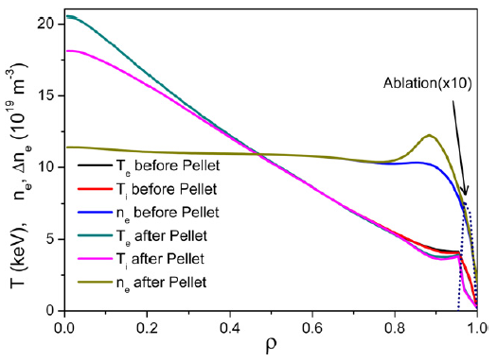
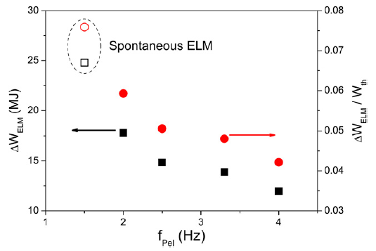
ELM Pacing by Pellets in KSTAR and ITER
Ki Min Kim et al, NF 51 063003 (2011)
Ki Min Kim et al, NF 50 055002 (2010)

Slide 51
Contents
  Simulation Setup
  - ELM
  - NTM
  - Momentum Transport
  Momentum Transport Simulation
  ELM Simulation
  - Sensitivity analysis
  - Small ELM event
  - Ideal MHD analysis
  NTM Simulation
  Real-time Control Simulation of NTM in KSTAR
  - Model validation
  - Feedback control simulation
  ELM Control by Pellets

Slide 52
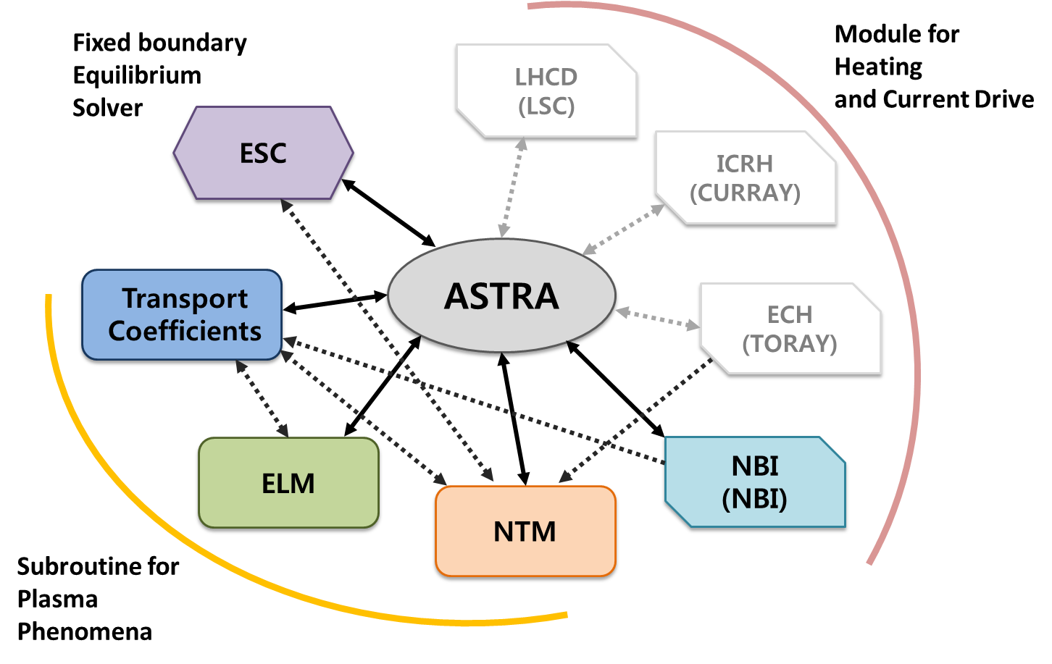

Slide 53
The modified Rutherford equation for NTM stability
1st : Conventional tearing mode stability:
assumed as for NTM
assumed as for NTM in ohmic phases*
2nd : Tearing mode stability enhancement by ECCD:
Westerhof’s model with no-island assumption
, where the misalignment function
3rd : Destabilisation from perturbed bootstrap current:
fitted by inferred size of saturated NTM island from ISLAND or estimated by experiments
for ohmic phases* (The bootstrap current term can be increased
when the heating is added.)
R. J. La Haye et al., Nuclear Fusion 46 451 (2006)
* O. Sauter et al., Physics of Plasmas 4,1654 (1997)

Slide 54
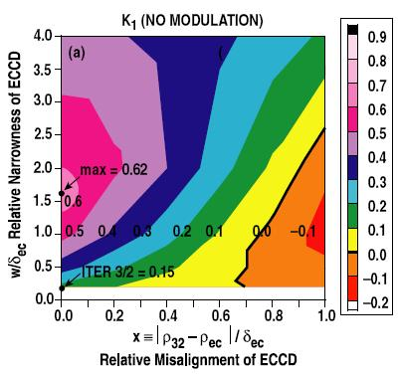
The modified Rutherford equation for NTM stability
4th : Stabilisation from small island & polarization threshold
(Glasser-Green-Johnson (GGJ) term ):
(= twice ion banana width)
where
and
for ohmic phases*
5th : Stabilisation from replacing bootstrap current by ECCD:
calculated from improved Perkins’ current drive model
6th : Stabilisation by the ECH effect**:
R. J. La Haye et al., Nuclear Fusion 46 451 (2006)
* O. Sauter et al., Physics of Plasmas 4,1654 (1997)
**D. De Lazzari et al., Nuclear Fusion 49, 075002 (2009)

