Slide 1
IOS-JA10: Scenario modeling for non-activation phase: a proposal
T. A. Casper
ITER Organization, Route de Vinon sur Verdon, 13115 St Paul Lez Durance, France
ITPA IOS meeting
October 18 – 21, 2011
Kyoto, Japan

Slide 2
ISO-JA10: Scenario modeling for non-activation phase
New task: define direction and seek volunteers
Change the name: Scenario modeling for low- and non-activation early operation of ITER
Need to include DD operation should this be more attractive than H or He
Dedicated to the “early” period of operation … defined as the first real operation with systems and diagnostics capable of L- and H-mode discharges
Objectives: Define a credible set of ITER scenarios
Demonstrate capability of achieving ELMing H-mode operation in H, D, and/or He suitable for ELM-mitigation studies
Determine adequacy of heating and current drive systems for scenarios needed to qualify ITER systems for DT operation
Provide equilibria and profile data for source modeling and evaluation
Benchmark simulated scenarios with experimental data
Plans for 2011-2012:
Specify characteristics of the scenarios, e.g. plasma species and heating systems
Develop a preliminary set of scenarios

Slide 3
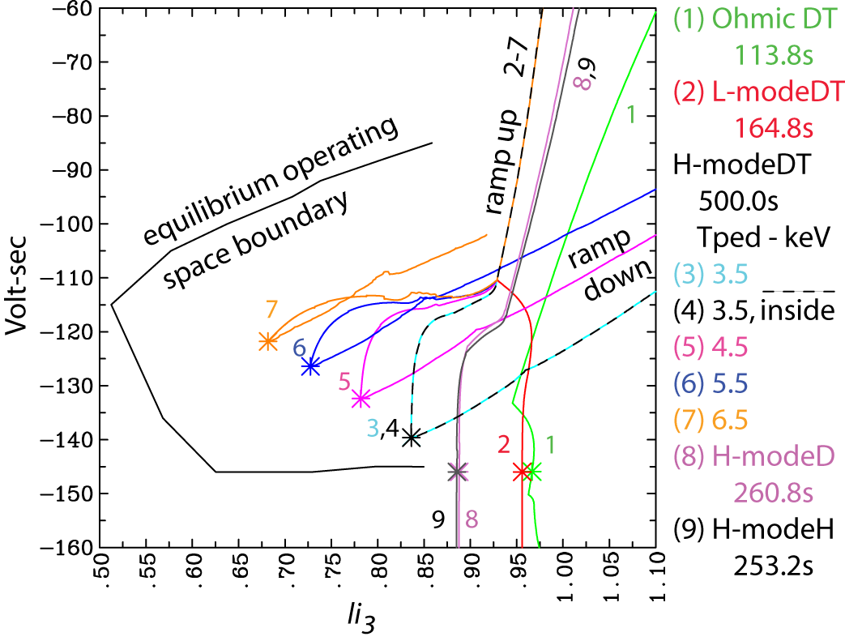
Preliminary simulations completed in 2010 with DD study recently done in 2011 … the “show something category”
H-scenario presented as part of the EU task yesterday – my 1st volunteers
Series of CORSICA simulations in H and D were completed in 2009/10 mostly to get a first estimate of discharge duration that might be possible
H-plasmas using the same prescription and shapes as the baseline inductive DT operation
Simulated Ohmic, L-mode and H-mode
Used only analytic sources - change to
Source models
Must be updated for changes to
ITER walls and coils
Divertor/wall awareness
DD scenario development (presented )
Provided estimate of tritium inventory
resulting from DD fusion reactions
A first attempt at a credible scenario with electron only heating
Demonstrated simulated control
Casper, T.A. et al, Nucl. Fus. 51 2011 (accepted)

Slide 4
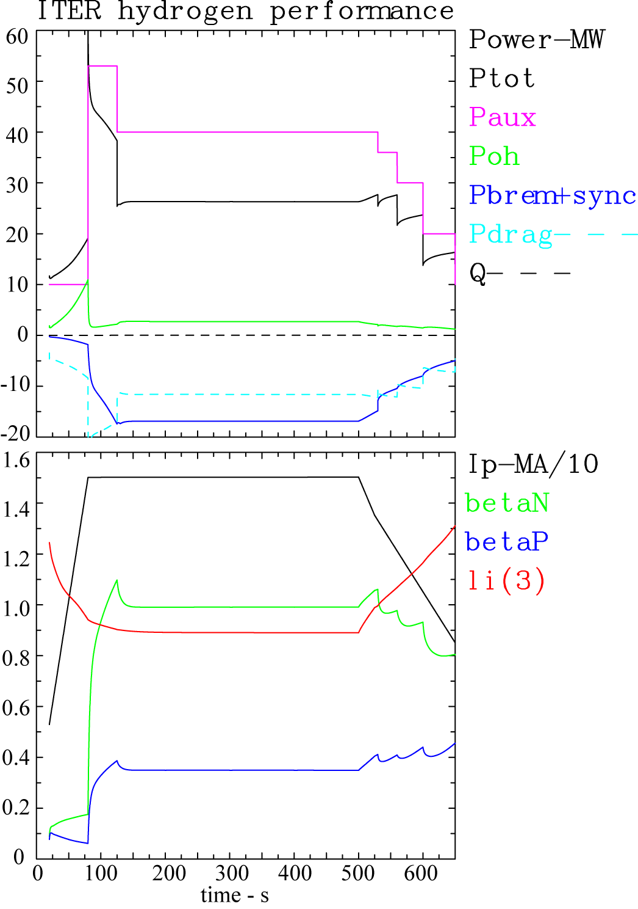
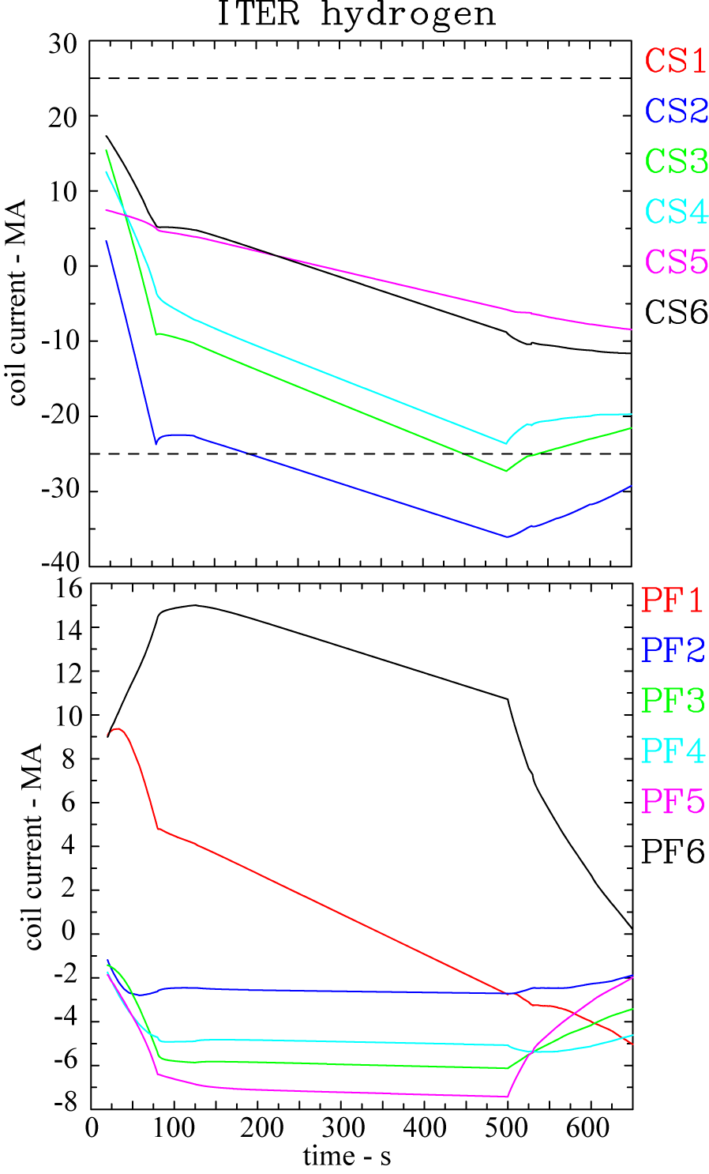
“Show some results” category: Hydrogen H-mode scenario – hits CS1,2 limit at 200s without the added Palpha heating

Slide 5
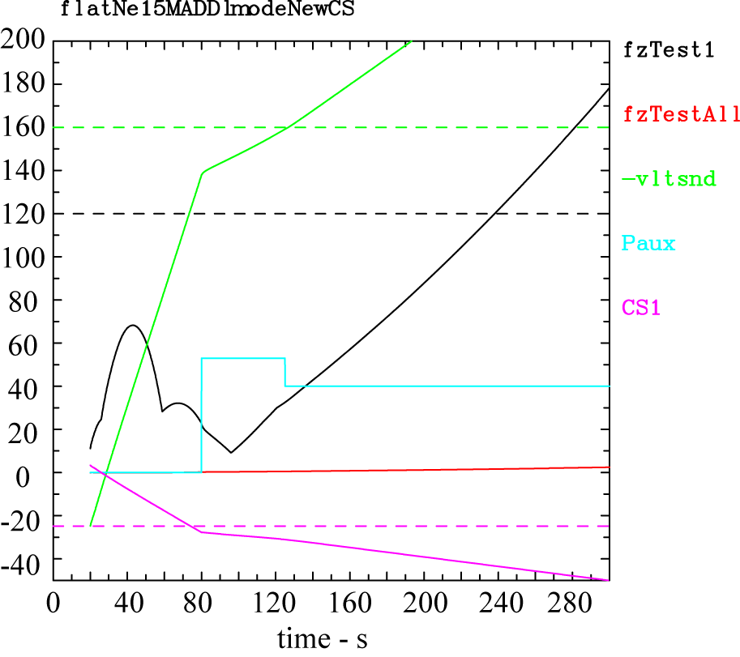
DD L- and H-mode scenarios were also run
DD H-mode is not significantly different than the H H-mode … very small amount of produced alpha heating
L-mode (picture) without early heating
CS1 limit at end of current ramp
Forces hit limit a little later, 120s
Need to optimize L-mode ramp up

Slide 6
Summary: need to define credible set early operations scenarios
Is it H, He, DD? All of the above?…. Develop scenarios to help decide
Credible L- and H-mode scenarios at 15MA that satisfy all constraints
Will have ECH, may have NBI (looking better now), what about ICH?
If we want ICH, need to make the case within the ITER design and cost constraints…coupling?
Set of “experiments” (e.g. scenarios) given the systems we expect to have … IO needs to help define this
What we really need
Volunteers accepted to help define this and do the simulations.
Experiments to benchmark simulations … maybe already have the data for ITER shape.

